Slide 1
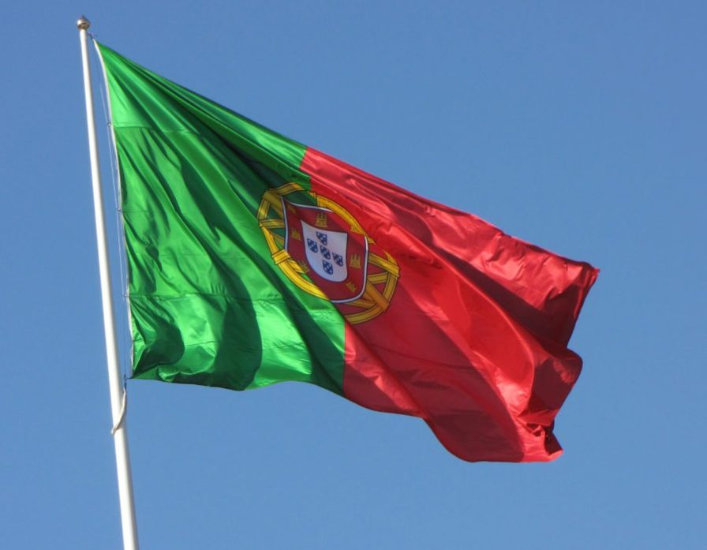

Slide 2
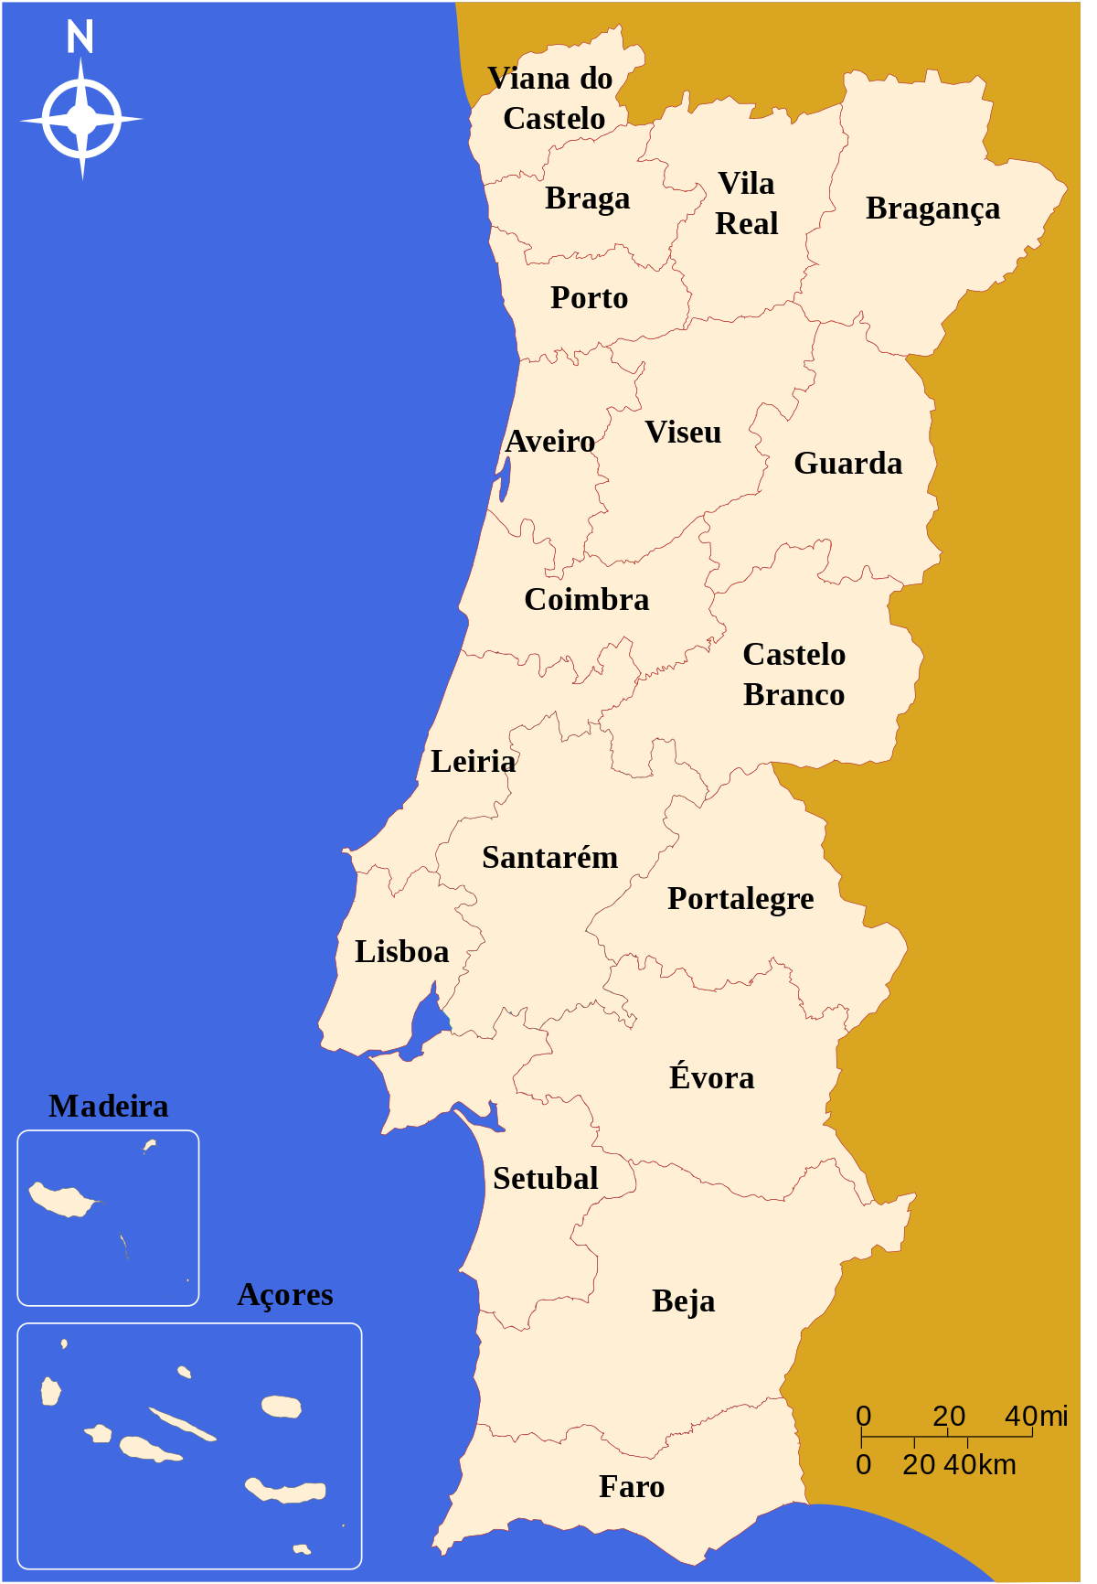
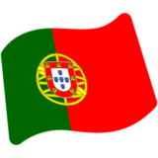
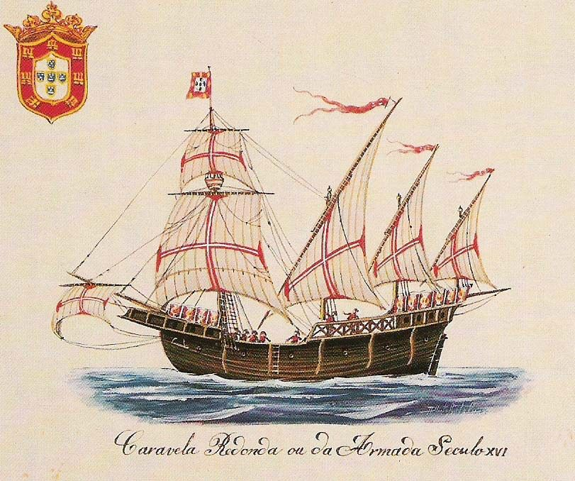
In the 15th and 16th centuries,
Portugal established the first global empire,
becoming one of the world's major economic,
political and military powers.
During this period, today referred to as
the Age of Discover
Portugal has left a profound cultural and
architectural influence across the globe,
a legacy of around 250 million Portuguese
speakers, and many Portuguese-based creoles
Notes:
Portugal is a country located mostly on the Iberian Peninsula
bordered to the west and south by the Atlantic Ocean and to the north and east by Spain
Its territory also includes the Atlantic archipelagos of the Azores and Madeira
Portugal is the oldest state on the Iberian Peninsula and one of the oldest in Europe
In the 15th and 16th centuries, Portugal established the first global empire, becoming one of the world's major economic, political and military powers

Slide 3
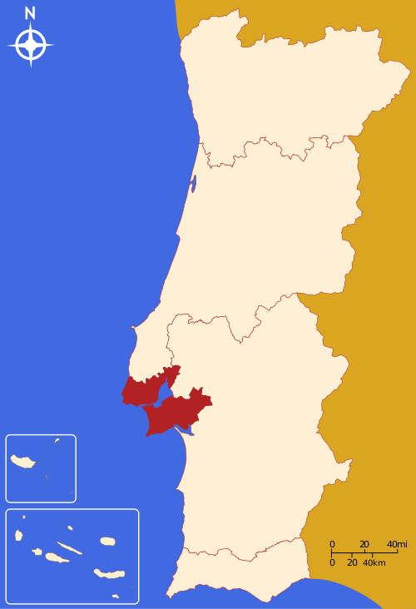
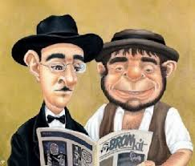
Population
Portugal’s Population is around 10,3 milion inhabitants
Lisbon metropolitan area, is the largest
population concentration in Portugal with almost 2,9
milion:
19.4% live in the city of Lisbon
about 26.7% of the total population of Portugal
lives in the Lisbon metropolitan area
(which is only 3.3% of the total area of Portugal)
Notes:
Portugal is a country located mostly on the Iberian Peninsula
bordered to the west and south by the Atlantic Ocean and to the north and east by Spain
Its territory also includes the Atlantic archipelagos of the Azores and Madeira
Portugal is the oldest state on the Iberian Peninsula and one of the oldest in Europe
In the 15th and 16th centuries, Portugal established the first global empire, becoming one of the world's major economic, political and military powers

Slide 4
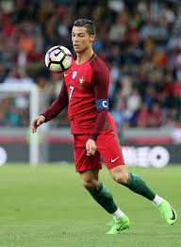
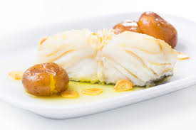
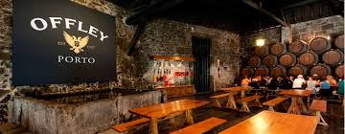
If you ask someone nowadays?
It’s the Country of Port Wine
Football player Cristiano Ronaldo
Salt Cod and Grilled sardines
Algarve's beaches as a major destination
Notes:
Portugal is a country located mostly on the Iberian Peninsula
bordered to the west and south by the Atlantic Ocean and to the north and east by Spain
Its territory also includes the Atlantic archipelagos of the Azores and Madeira
Portugal is the oldest state on the Iberian Peninsula and one of the oldest in Europe
In the 15th and 16th centuries, Portugal established the first global empire, becoming one of the world's major economic, political and military powers

Slide 5
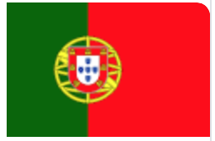
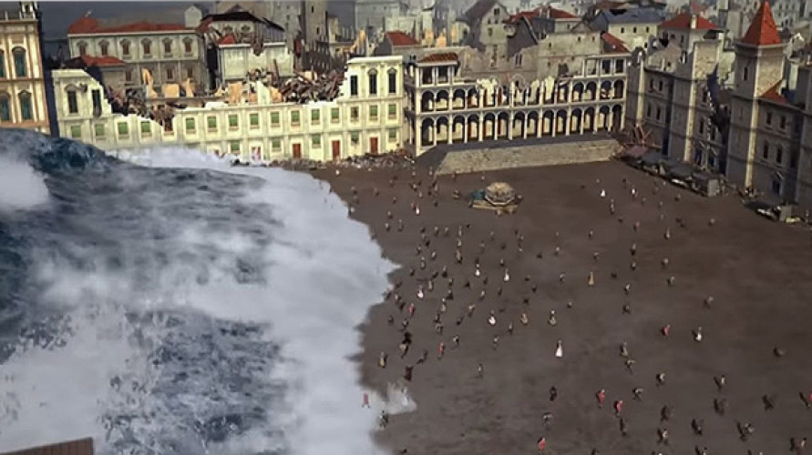
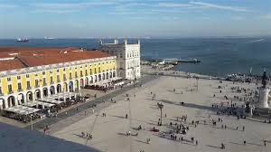
Lisbon is Portugal’s hilly, coastal capital city.
The 1755 Lisbon earthquake, also known as the Great Lisbon earthquake, occurred in the the morning of Saturday, 1 November, Feast of All Saints, In combination with subsequent fires and a tsunami the earthquake almost totally destroyed Lisbon and adjoining areas making it one of the deadliest earthquakes in history.

Slide 6
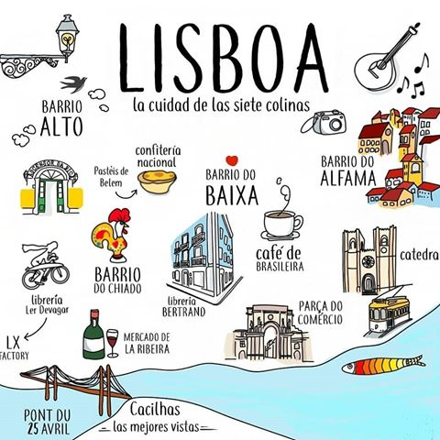
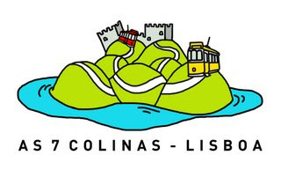
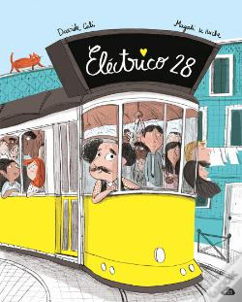

Slide 7
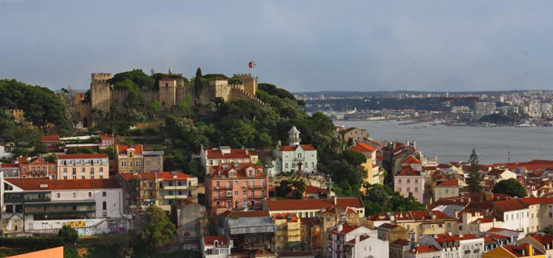
The City of the Seven Hills
These hills offer splendid views of Lisbon. No matter in which neighbourhood you are it is for sure you’ll find a panoramic viewpoint (called “Miradouro” in Portuguese) near by.

Slide 8
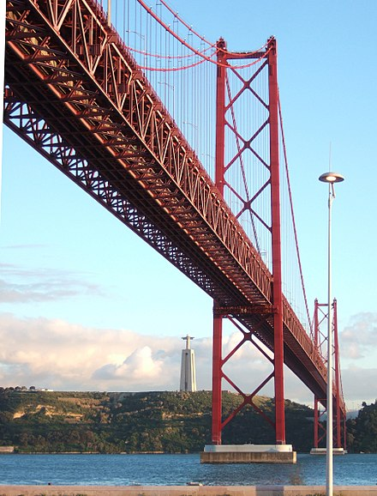
The 25 de Abril Bridge
It is often compared to the Golden
Gate Bridge in San Francisco, US,
because they are both suspension
bridges of similar color. It was built
by the American Bridge Company
which constructed the San Francisco
– Oakland Bay.

Slide 9
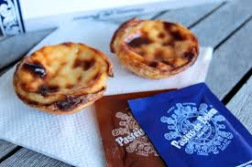
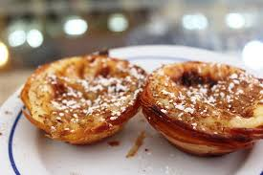
The City of Pastés de nata
It’s home to one of the world’s most top secret recipes:
Pastéis da nata, loved by locals and tourists alike for their flaky crust and creamy, sweet egg filling, have put Lisbon on dessert-lovers’ maps. Even though they are made all over the country and found in nearly every pastry shop, only 3 people in the world know the original recipe: the same one that is sold in Belém at Pasteis de Belém.

Slide 10
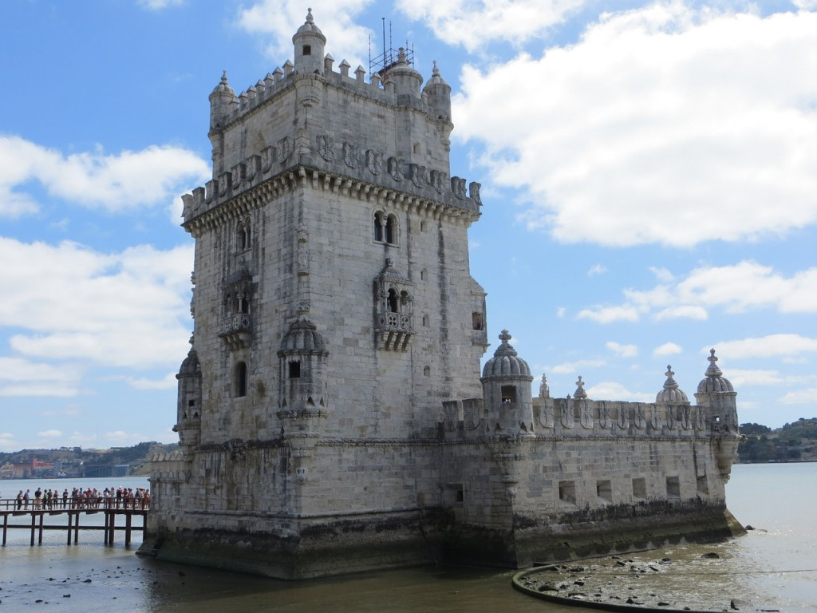
Also in Belém…
The beautiful Belém Tower is one of the city’s must-see landmarks and architectural wonders. It was built during the Age of Discoveries as a military fortification, but many people don’t know that it was used as a political prison during the the 19th century.

Slide 11
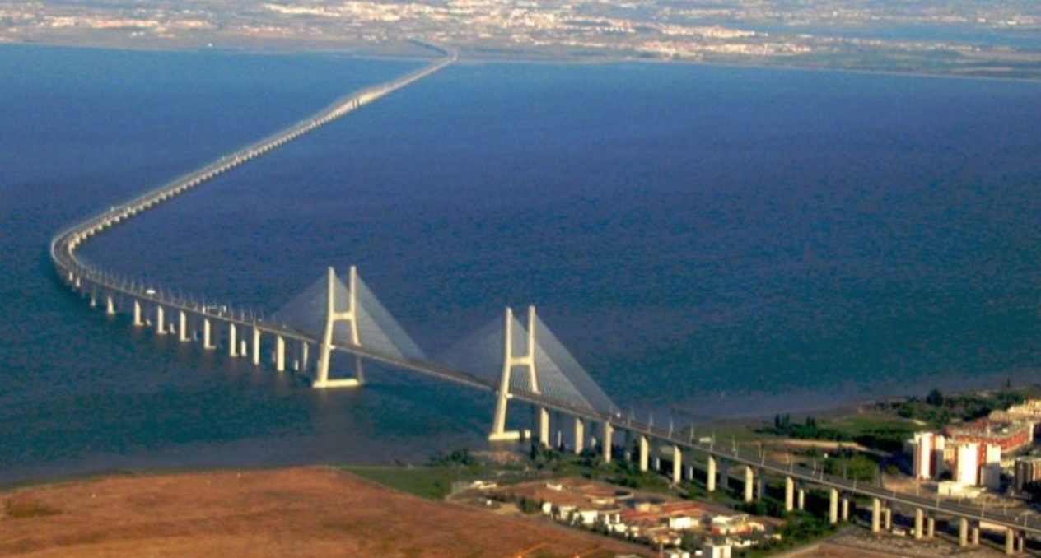
The city with the longest
Bridge in Europe
The longest bridge in Europe is the Vasco da Gama bridge with 17,185 meters long, crossing Tagus (Tejo) river

Slide 12
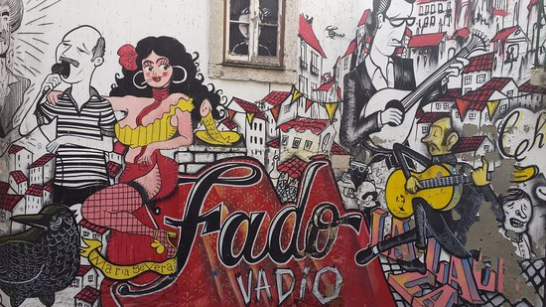
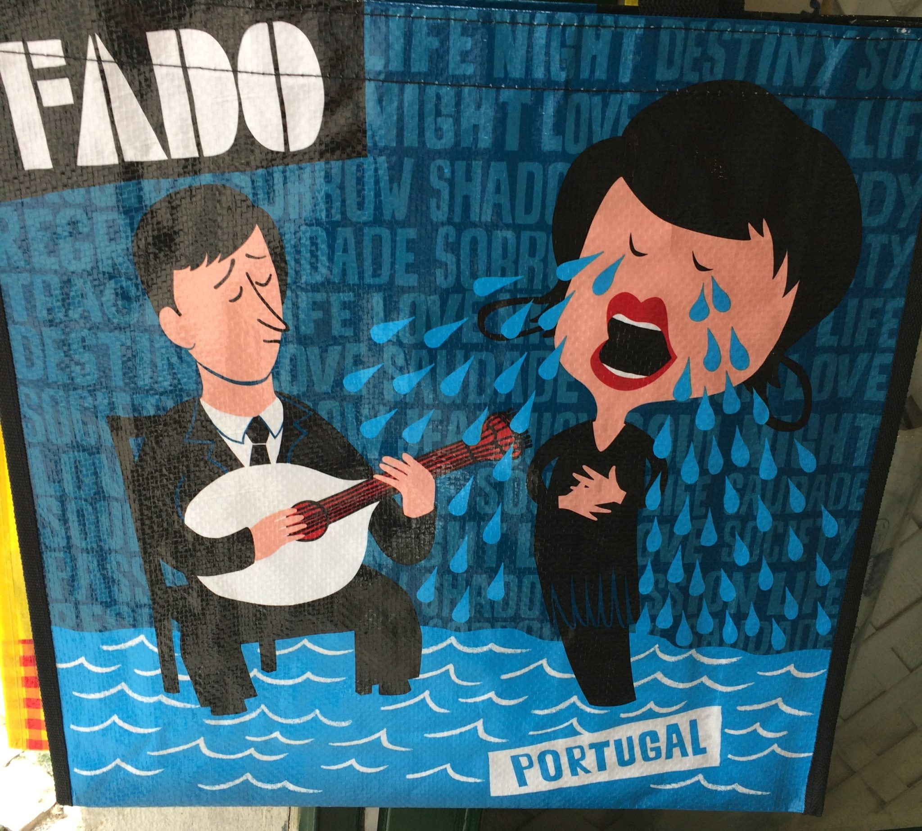
The city where FADO was born
FADO, is a music genre that can be traced to the 1820s in Lisbon.
Today fado is commonly regarded as simply a form of song which can be about anything,
but must follow a certain traditional structure.
In popular belief, fado is a form of music characterized by mournful tunes and lyrics, often
about the sea or the life of the poor, and infused with a sentiment of resignation, fatefulness
and melancholia.
This is loosely captured by the Portuguese word saudade, or "longing", symbolizing a feeling
of loss (a permanent, irreparable loss and its consequent lifelong damage).
On 27 November 2011, fado was added to the UNESCO Intangible Cultural Heritage Lists.

Slide 13
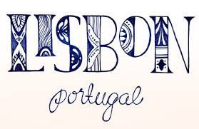
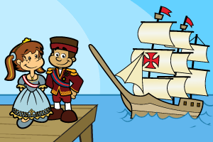
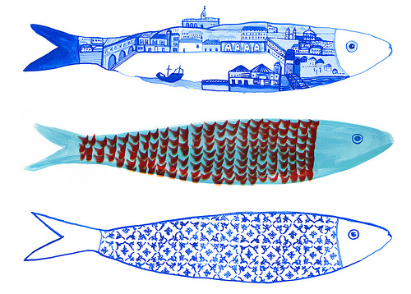
So… enjoy!!!
And after this fantastic conference, if you have time, try to “navigate”
and discover as much as you can about beautiful
And THANK YOU!!!

