Slide 1



Psycho Social Impact of diagnosis:
Patient diagnosis
Luzia Travado, PhD, MSc, ClinPsych
Psycho-oncology clinician and researcher
Champalimaud Clinical and Research Center,
Champalimaud Foundation,
Lisbon, Portugal
President Emeritus, International Psycho-Oncology Society

Slide 2



www.fchampalimaud.org
Lisbon, Portugal

Slide 3

summary
IPOS - Luzia Travado
Introduction
Impact of cancer and patients’ psychosocial needs
Consequences of severe distress & depression
Evidence-based Psychosocial interventions
Psychosocial care value for clinical outcomes
IPOS Standard for Quality Cancer Care
Notes:
It is helpful to recognize that bad news is in the eyes of the beholder, so that for some patients who are not expecting bad news, it may be particularly hard on them and for others who have some idea as to what is coming they may be more prepared for it. In other words this definition of bad news reflects the idea that bad news changes the view of the future for the beholder and can be variously upsetting depending upon what the person expects to hear from the bearer of the bad news.

Slide 4

Metaphor:
the impact of a cancer diagnosis ?
Nice, France

Slide 5
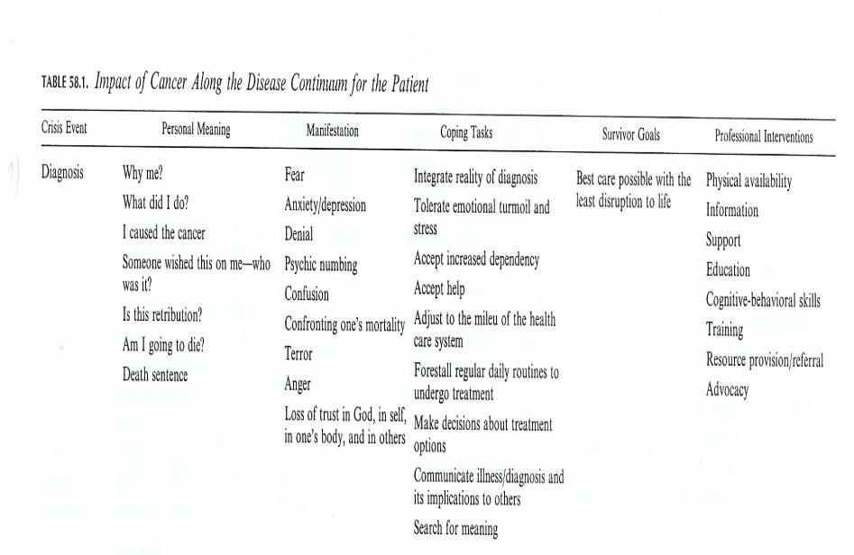
Crisis event: Diagnosis
Loscalzo and Brintzenhofeszoc. In Psycho-Oncology, Holland J (ed) 1998.

Slide 6
Impact of Cancer and its consequences
Family and interpersonal
uncertainty regarding social roles and tasks, separation from partners, children
Emotional and Psychological problems
fear, sadness, worries, despair, loss of autonomy and control, change of self-image
Existential and spiritual problems
Confrontation with the mortality of one’s own life, search for meaning, consolation; spiritual, religious, philosophical explanations
Patient
Physical symptoms and functional problems
pain, fatigue, dysfunction, sexual, appetite, sleep, psychosomatic symptoms, disabilities
Problems with the health care system
impersonal treatment, lack of time, lack of intimacy, terminology hard to understand
Social, financial, and occupational strain
Responsibility of important social and occupational functions, new dependencies
Koch & Mehnert, IPOS 2005
www.ipos-society.org
Notes:
6

Slide 7
DISTRESS in Cancer
Distress is a multifactorial unpleasant emotional experience of a psychological (i.e., cognitive, behavioral, emotional), social and/or spiritual nature that may interfere with the ability to cope effectively with cancer, its physical symptoms, and its treatment.
Distress extends along a continuum, ranging from common normal feelings of vulnerability, sadness and fears to problems that can become disabling, such as depression, anxiety, panic, social isolation and existential and spiritual crisis.
NCCN Clinical Practice Guidelines in Oncology,
Distress Management, 2017

Slide 8
DISTRESS CONTINUUM
Normal
Distress
adaptation
35 - 45%
Worries
Fears
Sadness
Severe
Distress
Psychosocial morbidity
25 - 45%
Maladjustment
Anxiety
Depression
Sub-sindrome
15-20%
Adapted from J.Holland, IPOS, 2005
www.ipos-society.org
Notes:
8

Slide 9
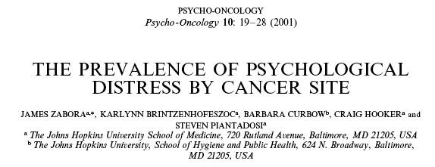
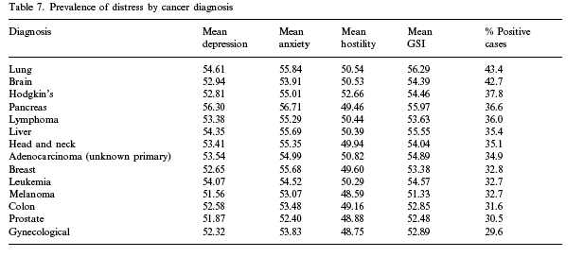
N=4496 cancer patients before treatment; 35,1%

Slide 10
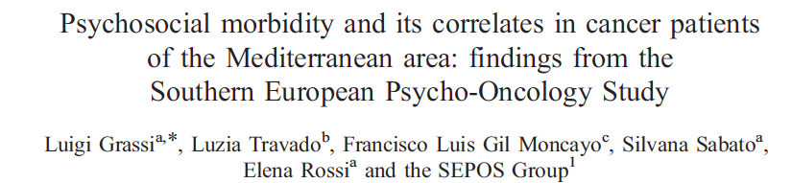
Cases of Anxiety → 34%
Cases of Depression → 24.9%
Maladaptive coping → 33.9%
Total psychological morbidity caseness → 28.5%
(No difference across countries - Italy, Portugal, Spain)

Slide 11

Prevalence of Anxiety and depression in MPN patients
N=2,029 patients completed HADS: (A) Anxiety – 21%, (D) Depression – 12%, both – 8%
Many participants who reported A or D exhibited mild symptoms
Middle-aged and elderly participants had lower A+D, compared to younger participants, and females had higher A compared to males
Participants with higher education had lower A compared to those with lower education
Current smokers and ex-smokers had higher A+D compared to non-smokers; sedentary participants or lower level of physical activity had higher A+D compared to participants who performed hard training several times a week
Higher comorbidity burden, increased D, and greater financial difficulties increased A+D
Higher total symptom burden and fatigue burden and higher level of sexual problems increased A+D
Lower functional level and global health/QoL increased A+D
BMI, alcohol intake, comorbidity burden, and duration of disease were not substantially associated with A; gender, educational level, and duration of MPN disease were not substantially associated with D
Conclusion: There may be an unmet need in handling psychological distress in MPN patients
Anxiety and depression in patients with Philadelphia-negative myeloproliferative neoplasms:
a nationwide population-based survey in Denmark. Brochmann N, et al. Clin Epidemiol. 2019; 11: 23–33.
Luzia Travado

Slide 12
In univariate and multivariate analyses, almost all PPL items were associated with distress, depression, and/or anxiety.
Conclusion—Physical symptom burden in MPN patients was clearly associated with psychological symptoms. Depression was uniquely associated with overall physical symptom burden. As such, the endorsement of multiple PPL items on the DT&PL should prompt an evaluation for psychological symptoms to improve MPN patients’ overall morbidity and QoL.
Luzia Travado

Slide 13

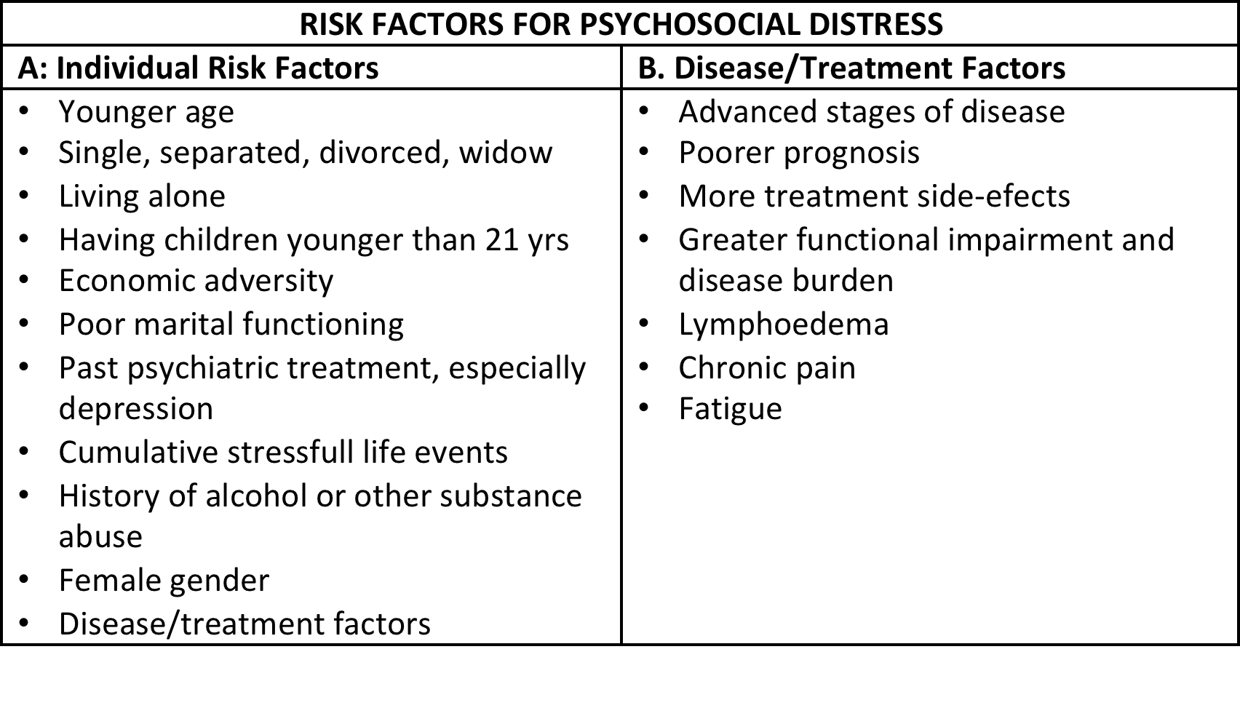
http://canceraustralia.gov.au/sites/default/files/publications/pca-1-clinical-practice-guidelines-for-psychosocial-care-of-adults-with-
cancer_504af02682bdf.pdf

Slide 14
Consequences of Psychological Morbidity in Cancer Patients: impact on Clinical outcomes
Deterioration of Quality of Life
Reduced compliance w/ treatment
Less efficacy of chemotherapy
Higher perception of pain and other symptoms
Shorter survival expectancy
Longer hospital stay and increased costs
Burden for the family
Higher risk of suicide
Parker et al., Psychooncology, 2003; Colleoni et al., Lancet, 2000; Walker et al., EJC, 1998; Spiegel et al., Cancer, 1994; Faller et al., Arch Gen Psychiatry, 1999; Watson et al., Lancet, 1999; Pitceathly & Maguire, EJC, 2003; Prieto et al., J Clin Oncol., 2002; Henriksson et al., J Affect Dis, 1995; Grassi et al. 2005; McDaniel et al. 1995, Ehlert 1998, Saupe & Diefenbacher 1999, Linton 2000, Cavanaugh et al. 2001, Härter et al. 2001, Carlson & Bultz, 2004; Watson et al., 2005
adapted from Grassi & Yosuke, IPOS online curriculum: www.ipos-society.org

Slide 15

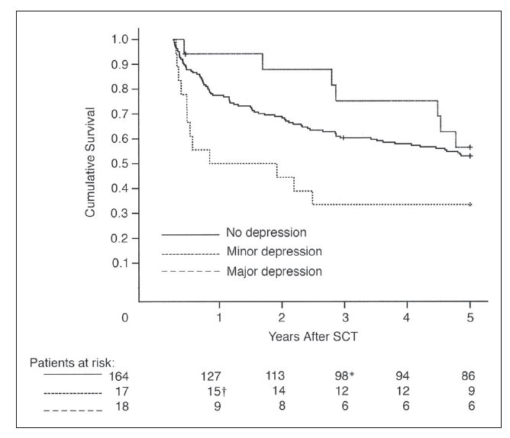

Depression and survival

Slide 16
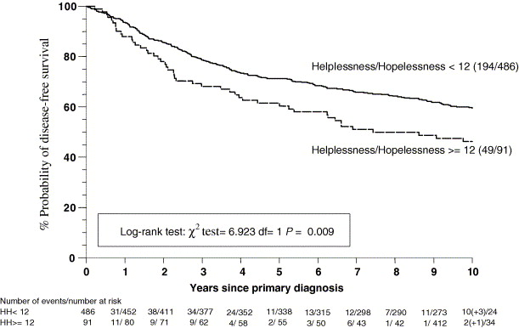
Influence of psychological response (coping) on breast cancer survival: 10-year follow-up of a population-based cohort
Watson M et al. European Journal of Cancer, 2005
Notes:
16

Slide 17
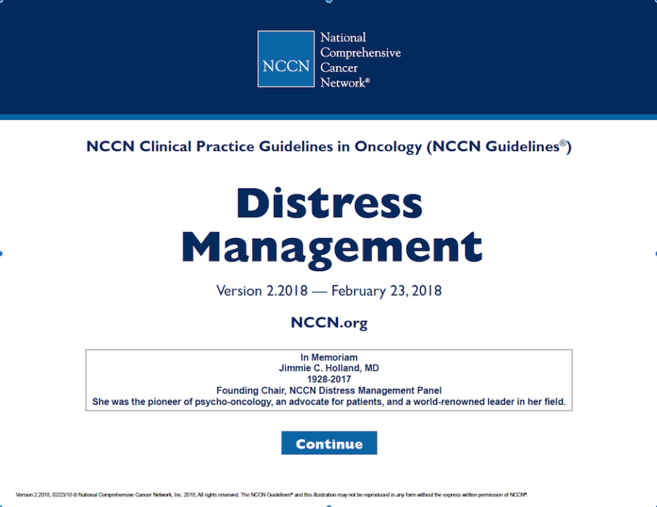

Slide 18
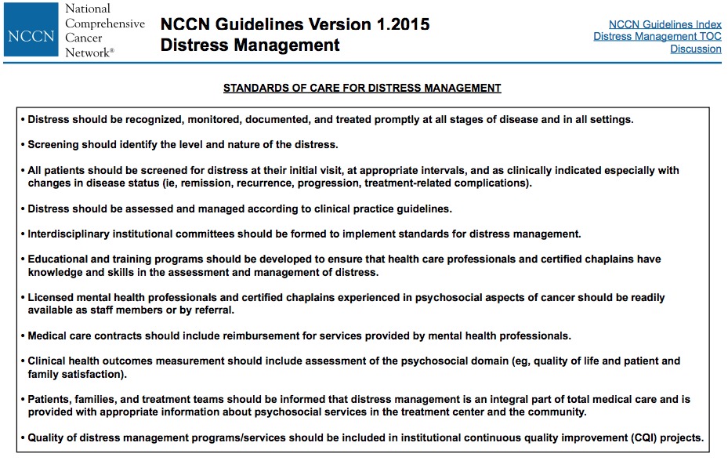

Slide 19
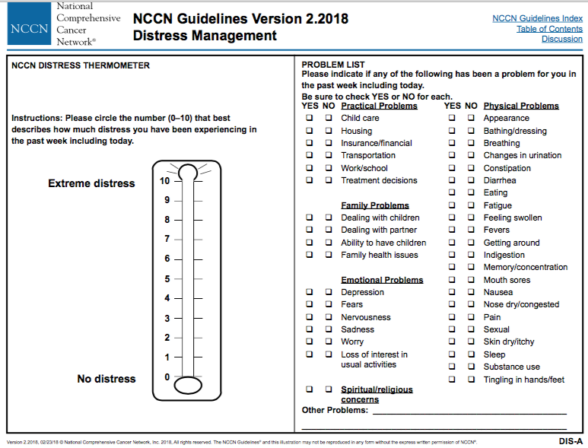
Notes:
19

Slide 20
Types of Psychological Interventions
Psycho-educational interventions (information about the disease process, coping w/ disease and resources available)
Individual psychotherapy (targets emotions, coping, self-efficacy, self-esteem) > efective in emotional and functional adjustment
  3. Cognitive-behavioral therapy (targets maladaptive thoughts, feelings and behaviors that contribute to symptoms) > effective
  (e.g., Adjuvant Psychological Therapy, Greer et al., BMJ, 1992)
4. Group interventions (by patients or professionals; targets social support, destigmatization, communication, hope, meaning in life by helping others)
  (e.g., Supportive-Expressive Therapy, Spiegel et al., Psycho-Oncology, 1999; Classen et al., Arch Gen Psychiatry 2001; Cognitive-Existential Group Therapy (Kissane et al., Psycho-Oncology, 2003; Meaning Centered Group Psychotherapy , Breitbart et al. Supportive Care in Cancer, 2002)
Edwards, Hulbert-Williams & Neal, Psychological Interventions for women w/ mBC (review), The Cochrane Collaboration, 2008

Slide 21
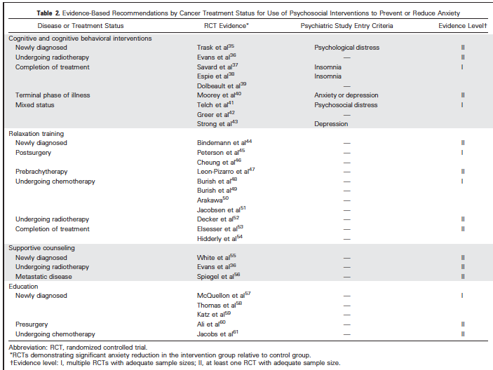
Traeger et al. Evidence-based Treatment of ANXIETY in Patients with Cancer. JCO 2012, 30: 1197-1205.

Slide 22
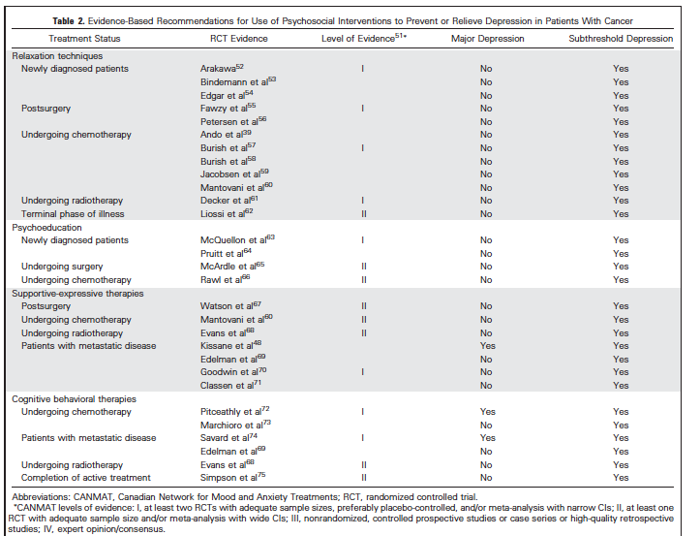
Li, Fitzgerald & Rodin. Evidence-based Treatment of DEPRESSION in Cancer Patients. JCO 2012, 30: 1187-96.

Slide 23
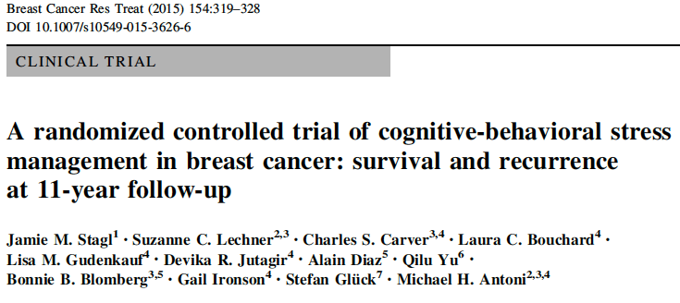
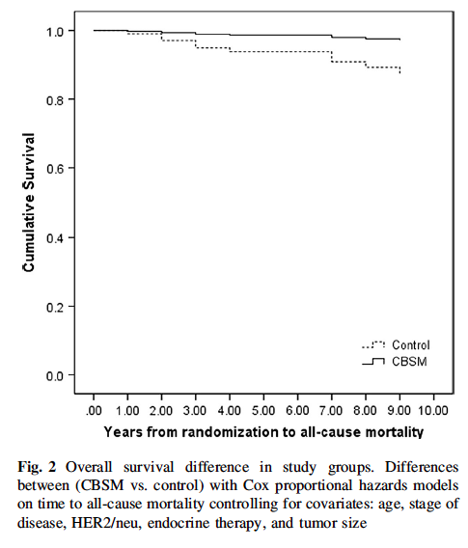
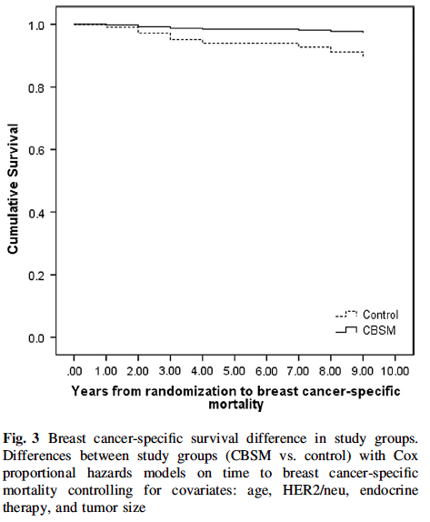

Slide 24

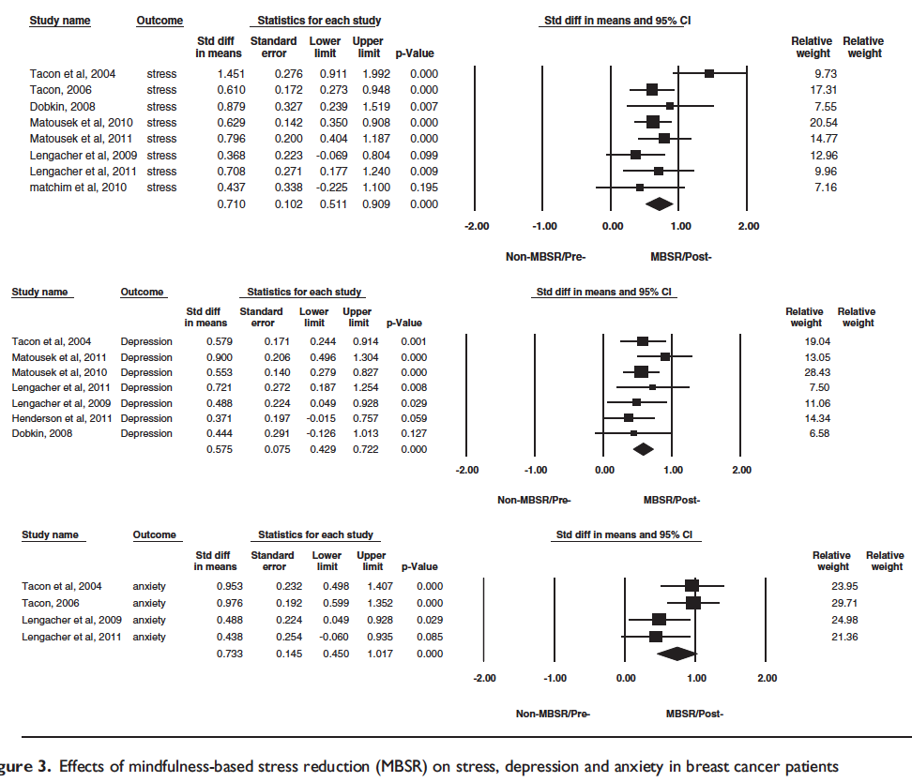
Conclusion:
MBSR shows a moderate to large positive effect size on the mental health of breast cancer patients

Slide 25
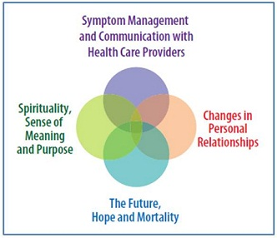
CALM Therapy for Advanced cancer patients: Managing Cancer and Living Meaningfully
Brief intervention: 4-6 sx
reducing and preventing psychological distress
RCT: 52% reduction in depressive symptoms after 3 months, with a 65% reduction in 6 months of follow-up, versus 35% in the control group
PT validation at CCC 2018 -
Rodin G. 2017
ASCO Annual Meeting
Notes:
Brief, semi-structured, evidence-based, psychotherapeutic intervention for advanced cancer patients and their primary caregivers.
- It is designed to help people with metastatic cancer and their caregivers manage the practical and profound problems associated with advanced disease. - The primary goals of

Slide 26
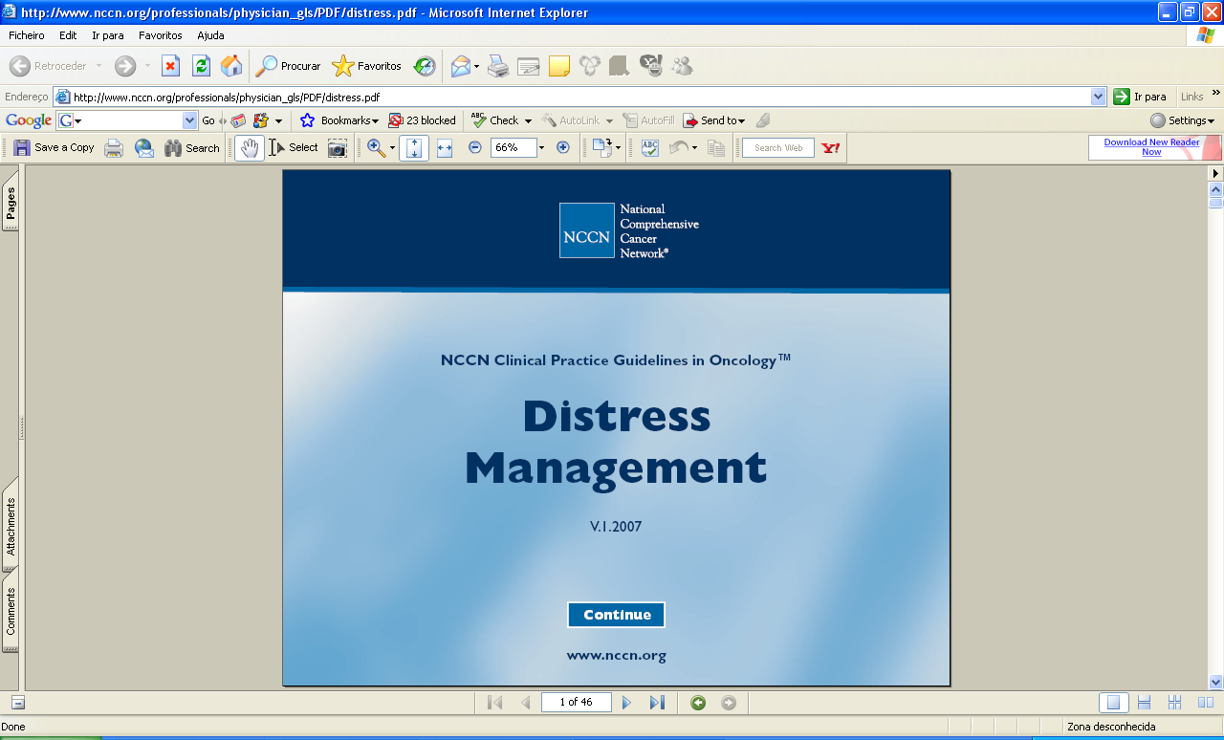







Slide 27
Integration of Psychosocial Oncology Care in Routine Oncology
IPOS - Luzia Travado
Psychosocial Oncology Care is an important element of high-quality care
Psycho-oncology services provide effective (evidence-based, RCT’s) interventions for:
(a) reducing distress and preventing psychosocial morbidity associated w/ cancer
(b) improving patients’ skills to cope with the demands of treatment and the uncertainty of the disease
(c) improving their Quality of Life
(d) improving clinical outcomes
>> And are cost effective as well as general health costs reductive
Notes:
27
> However these interventions and services are not yet regularly offered and included in routine clinical cancer care…

Slide 28

IPOS Statement on Standards and Clinical Practice Guidelines in Cancer Care (2009 updated 2014)
Psychosocial cancer care should be recognised as a universal human right;
Quality cancer care must integrate the psychosocial domain into routine care;
Distress should be measured as the 6th vital sign after temperature, blood pressure, pulse, respiratory rate and pain.
Endorsed by UICC and 75 cancer organizations worldwide

Slide 29


Integration of Psychosocial Oncology Care in Routine Oncology
IPOS - Luzia Travado
Since its adoption by IPOS and the IPOS Federation of Nat’l Psycho-oncology Societies in 2010, the Standard has been endorsed by 75 organisations worldwide.
In 2013 the Union for International Cancer Control (UICC) revised the World Cancer Declaration to include the codification of distress screening:
Target 8: Effective pain control measures, and distress management, will be available to cancer patients in all countries.
Notes:
29

Slide 30
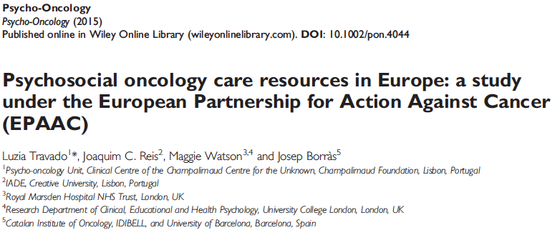


EPAAC – WP7 on Healthcare
Psychosocial Oncology Action
Preliminary results from the European survey N=27/30 countries (87%) (2013)
1. National Cancer Control Plan (NCCP)
Psychosocial Care included in 21/27 NCCP (77,8%)
Budget only 10/27 (37%)! for these clinical services
Travado et al. Psychosocial Oncology Care Resources in Europe: a study under the European Partnership on Action Against Cancer [EPAAC]. Psycho-oncology 2015; DOI: 10.1002/pon.4044

Slide 31
EPAAC – WP7 on Healthcare
Psychosocial Oncology Action
Preliminary results from the European survey (27 countries)
1. NCCP: Provision responsibility of PSOC
Travado et al. Psycho-oncology 2015

Slide 32
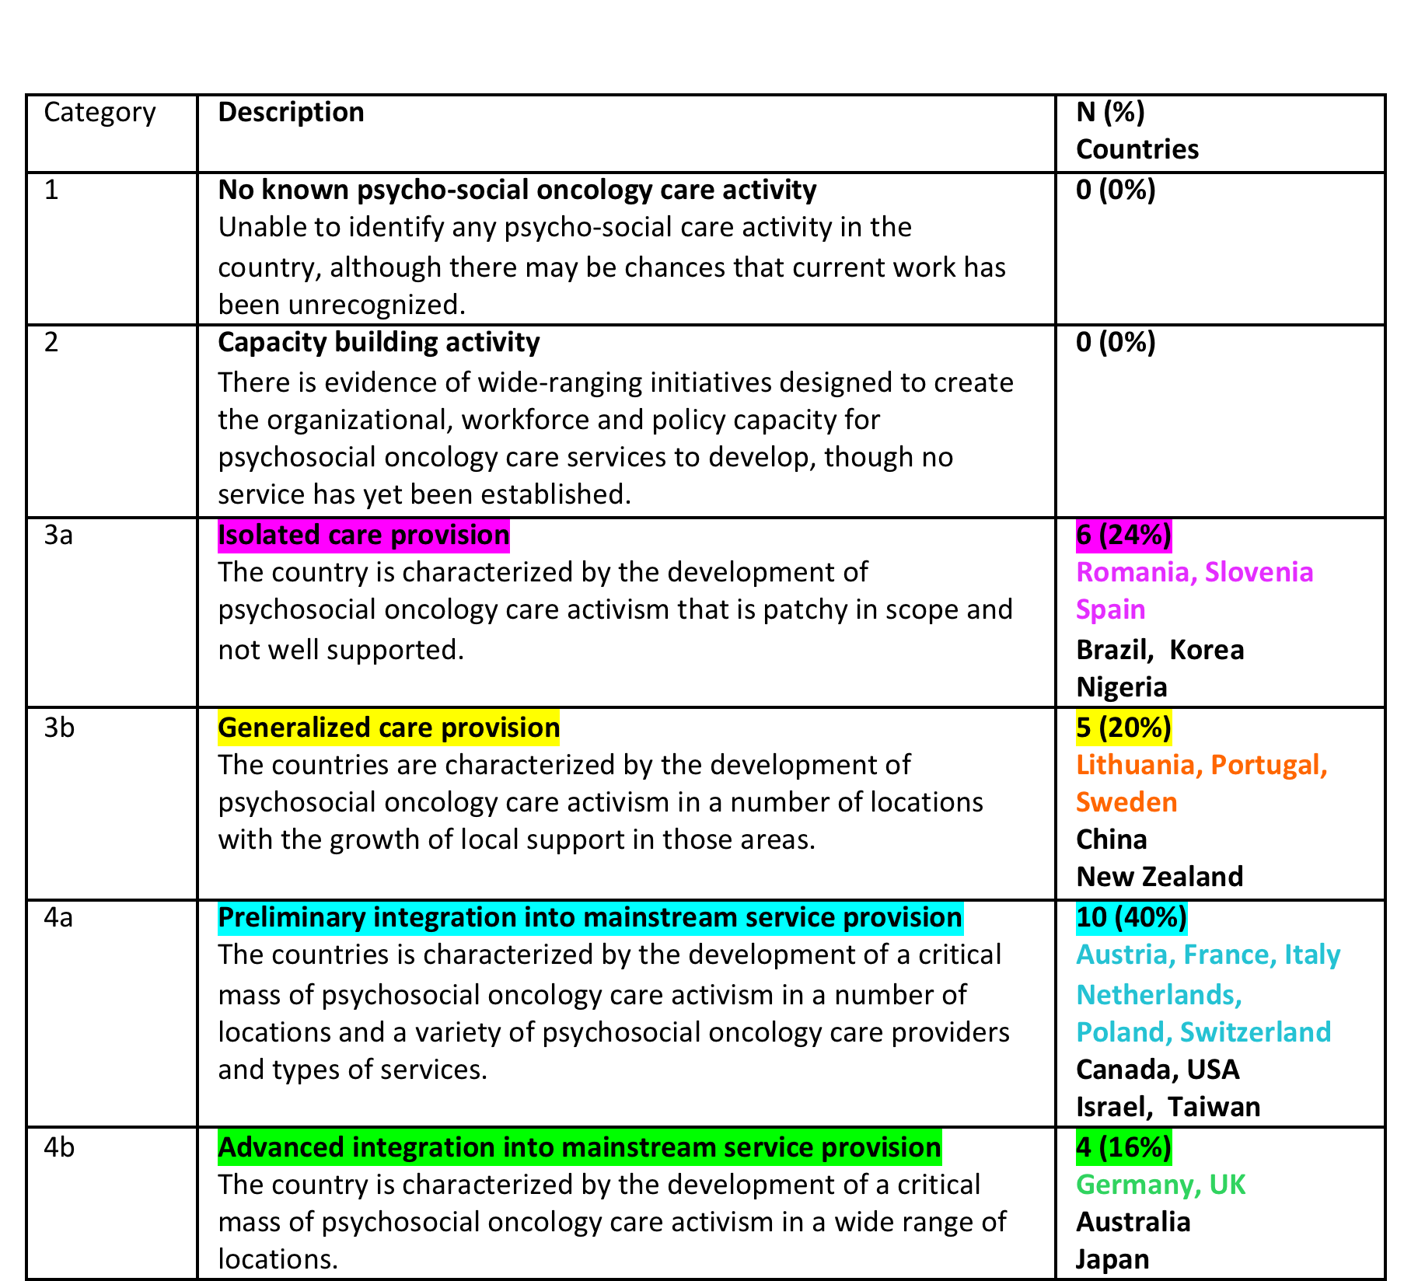
Self-reported level of development in psychosocial oncology practice among 25 countries
(out of 28) belonging to the IPOS Federation of psycho-oncology societies (14 European)
Travado et al. 2015 President’s Plenary International Psycho-Oncology Society: Psychosocial Care as a Human Rights Issue - Challenges and Opportunities. Psycho-oncology under revision

Slide 33
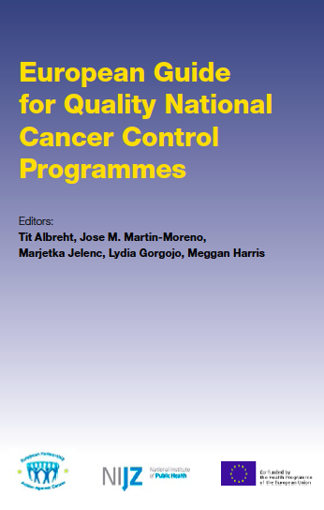


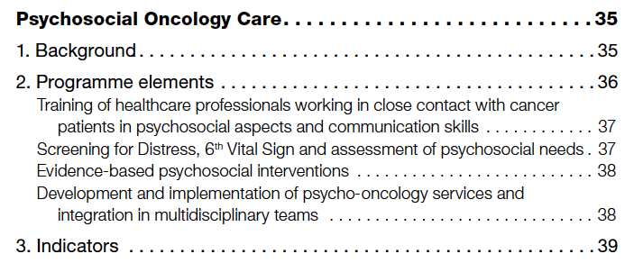
http://www.cancercontrol.eu/uploads/images/European_Guide_for_Quality_National_Cancer_Control_Programmes_web.pdf

Slide 34

Programme elements
NCCP needs to include the following elements for quality psycho-oncological care:
Integration of Psychosocial Oncology Care in Routine Oncology
IPOS - Luzia Travado
Training of health care professionals in the psychosocial aspects of cancer
Inclusion of routine Screening for Distress, the 6th Vital Sign∗ of cancer patients
Employ evidence-based treatments for symptoms and psychosocial needs identified through Screening for Distress
Development of minimum practice standards in Psycho-oncology Services
Implementation and integration of psycho-oncology programmes into cancer multidisciplinary teams (MDTs)
Allocation of funds at the NHS to ensure that comprehensive cancer care includes psychosocial care as standard

Slide 35




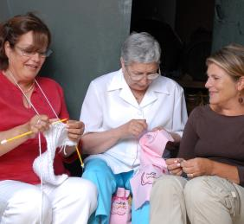








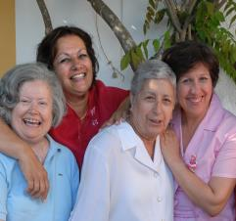
Add quality to life project

Slide 36
Thank you
www.fchampalimaud.org
Lisbon, Portugal

