Slide 1

Introduction – Patient Advocacy & Support Group in India
By Param – Trustee Friends of Max, India
Advocacy Session #2
How to be an Effective Advocate
#MPN Horizones 2019

Slide 2
CML Patient Support Group – Introduction
Friends of Max – A support arm of Max Foundation USA
Friends of Max is a Patient support group focussing on CML ( chronic Myeloid leukemia a type of blood cancer & GIST - Gastro instestinal stomach tumor) formed by cancer survivors and their care givers. Our mission is to provide emotional and practical support to these patients and their families.
Friends of Max is registered as a Government recognized Charitable Trust by the Charitable Commissoner's office in Mumbai. It has more than fifteen city chapters across the country.
Over the last ten years, Friends of Max has taken great pride in having been the vehicle for many positive, productive and result oriented interventions like
1) Providing a platform to patients and their Care givers to share and learn from each other's experience by arranging regular meetings with the best of the oncologists and Haemotologists in one on one Patient Physician interactions
2) Training volunteers who would like to help fellow survivors live a positive and confident life
3) Organizing events to spread awareness about the disease and the importance of compliance
4) Provide assistance and facilitate to monitoring tests for financially challenged patients.
Friends of Max few milestones -
Over 150 meetings in 20 cities
More than 10000 survivors educated
More than 260 volunteers trained.
Friends of Max also has a Medical Advisory Board consisting of top 11 Haemotologist/ Oncologists from best hospitals
FOM Board of Trustees consists of 12 trustees including me.
Standing Committee of FOM India has approved to support in Establishing MPN Support Group thereby a Legal Entity is available to get necessary sponsorship
Max Foundation has also agreed to provide support to establish the MPN Patient support group in India
Advocacy Session #2
How to be an Effective Advocate
#MPN Horizones 2019

Slide 3
Patient Advocacy in India
MPN Support Group in India
  At present there is no Support Group for MPN in india
  CML & GIST has a Support Group from Friends of Max
  Bringing together the MPN patients across Pan India along with the treating doctors, caregivers is the Goal post MPN Horizons
  Partnering with MPN Network groups can be leveraged to engage in raising awareness of Patient support available for all type of Blood Disorders
  Build a framework to connect, Engage, Share and learn best practices…….
Advocacy Session #2
How to be an Effective Advocate
#MPN Horizones 2019

Slide 4
MPN Patient Support Group Update
MPN Patient Support Group link is made in FOM Website
Designed Introductory letters on MPN India Patient Support Group and shared with Leading Haematologists
Feedback from the Doctors –
  MPN is very diversified across Pan India
  Patients initially come to oncologists but move for routine treatment with the GP;s
  Follow ups are very slow and mostly older patients
  Labs are the touch point to establish patient data base
  Engaging leading Labs to get the patient data base
Advocacy Session #2
How to be an Effective Advocate
#MPN Horizones 2019

Slide 5
MPN Patient Support Group Update
Engaged with MPN Network organizations in USA, Canada, UK and Europe
Received information regarding the disease profiles
Website on MPN Support Group work is initiated – Plan to go Live by End of Nov/Dec
Continued engagement with treating doctors on MPN support Group availability
Got introduction from Nepal to assist a lead to support group in that country
Advocacy Session #2
How to be an Effective Advocate
#MPN Horizones 2019

Slide 6
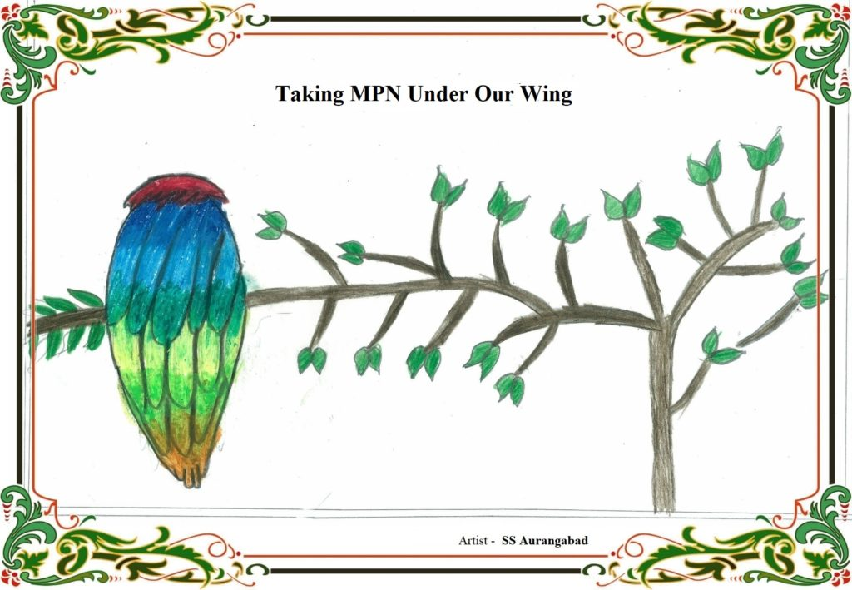
Patient Advocacy in India
Advocacy Session #2
How to be an Effective Advocate
#MPN Horizones 2019

Slide 7
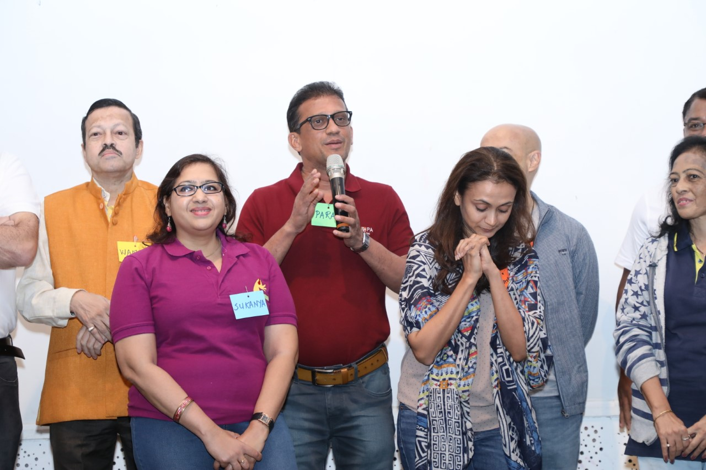
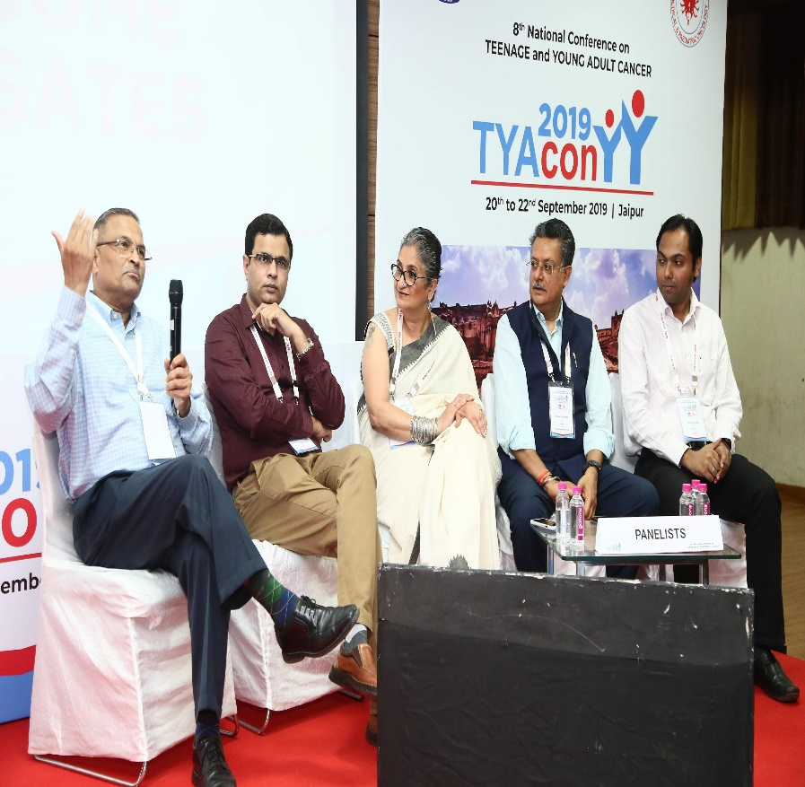
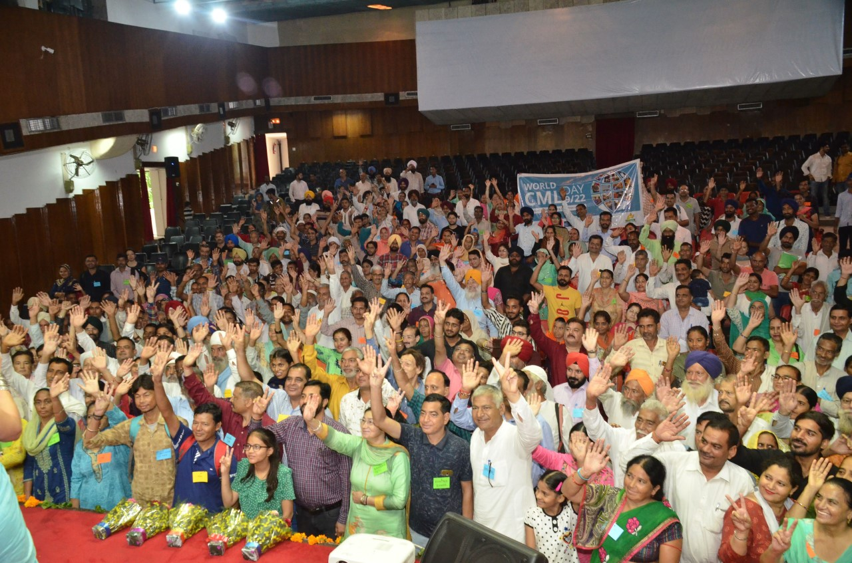
Patient Advocacy in India
Advocacy Session #2
How to be an Effective Advocate
#MPN Horizones 2019

Slide 8
Advocacy Session #2
How to be an Effective Advocate
#MPN Horizones 2019

