Slide 1
Patient-Reported Outcomes:
The Role of Advocates
Jon Mathias, MPN Advocates Network, MPN Voice

Slide 2
Patient-Reported Outcomes (PROs)
What do we mean by Patient-Reported Outcomes?
Why are PROs important?
PROs in Health Technology Assessments
The role of Patient Advocates and Patient Organisations

Slide 3
What are Patient-Reported Outcomes?
Traditionally, measuring the success or otherwise of a therapy or intervention has been part of the clinician’s job
Patient-Reported Outcomes (PROs, sometimes PROMs) are a way of measuring success by the patient
PROs usually use a standardized questionnaire and scoring system that ask patients about the factors that matter to them
PROs have been growing in their use over the past 10-15 years and are increasingly involved in Health Technology Assessments
A related idea is Patient-Reported Experience (PRE), which is where patients provide an assessment of their Quality of Life generally, and not specifically as a measurement of a therapy’s success

Slide 4
Why are PROs important?
We live in a data-driven world
Professional judgement needs to be backed by quantitative information
But our bodies don’t talk to us in numbers; we only know how we feel on a day-today and month-to-month basis
PROs can be seen as a bridge between feelings and data
PROs can potentially translate what patients know into evidence that professionals can confidently act upon

Slide 5
PROs for MPNs
Ruben Mesa says:
“Validated MPN PROs allow for precise and rapid assessment of the MPN symptom burden in clinical and trial settings. Their growing use among investigators has resulted in improved understanding of how the MPN disease burden and overall patient experience is impacted by novel and traditional therapies. PRO tools are an integral part of National Comprehensive Cancer Center (NCCN) guidelines for MPN treatment and should be regularly employed in disease burden assessment”

Slide 6
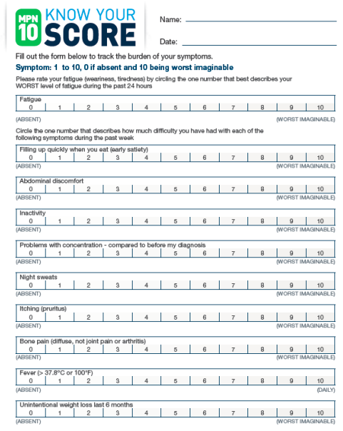
MPN-SAF TSS (MPN-10)
MPN-10 is the primary PRO/PRE tool in MPNs
It enables patients to quantify their symptoms using a 0-10 score across 10 categories of symptom
Originally developed in booklet form, it is now becoming available as apps that can optionally create a downloadable record of symptom progression

Slide 7
PROs in Health Technology Assessment
PROs are important for helping a clinician fully assess an individual patient’s need
PROs have an even more important role in supporting decision-making at a population level
Health Technology Assessments (HTAs) are the process by which new therapies are judged in terms of effectiveness and value for money
Clinical trial data is still the dominant category of information used in HTAs, but PROs and PREs are increasingly being incorporated into the process

Slide 8
Quality of Life
HTAs need to be able to judge the “quality” of a patient’s life
Quality of Life
“perfect health”
Time

Slide 9
Burden of Illness
An illness or injury reduces quality of life
More adverse symptoms and complications decrease the quality of a patient’s life and increase the “Burden of Illness”
Quality of Life
Burden of Illness
Time

Slide 10
Benefit of Therapy
A treatment for the illness will restore some of the patient’s quality of life
The Benefit of the therapy is the amount of life quality that is restored
Quality of Life
Benefit of Therapy
Time

Slide 11
The 2 Questions
“How good is the drug?”
The greater the benefit, the more likely the therapy is to be approved
The size of the benefit depends on two questions:
How good is the drug?
How bad is the illness?
Quality of Life
“How bad is the illness?”
Time

Slide 12
Who are the experts?
  Drug Developers
  Clinicians
  Patients
The developers of the therapy and clinicians are the experts in the drug’s effectiveness
Patients are the experts in the effects of the disease and the Burden of Illness
A PRO/PRE methodology provides a systematic data-based answer to the question “How bad is the illness?”
Quality of Life
“How good is the drug?”
  Patients
  Clinicians
“How bad is the illness?”
Time

Slide 13
The Role of Advocacy and Patient Organisations
In our role as advocates and advisors for patients, we can explain to patients the need to quantify their feelings
Promote the use of standardized tools as a way of enriching patient-clinician communication
Help patients create a longitudinal (over a long time) record
In our role as representatives of our MPN patient communities, we can build datasets that prove our case
PREs – use the same tools to create a quantified measurement of the burden of illness
PROs – by presenting standardized data that records the benefits of a therapy in the terms that matter to patients

Slide 14
Thank You

