Slide 1
Yvonne Francis Clinical Nurse Specialist Guys and St Thomas’ NHS Foundation Trust London
The Role of the Clinical Nurse Specialist : Self Management
Treatment

Slide 2
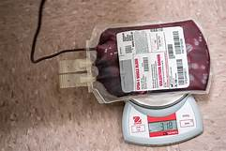
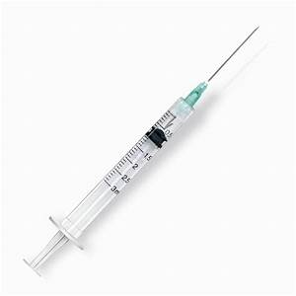
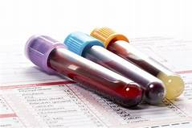
Treatment Management Vs Self Management
Patient as a person
Personalised
Coordinated
Enabling

Slide 3
What is the
matter with
you?
What matters
to you?

Slide 4
Self Management
‘ Approaches used by the individual affected by cancer and its effects to
optimise living with the illness and its effects’
Foster et at 2007 - Defining Self Management
‘An awareness and active participation by the person in their recovery
recuperation, and rehabilitation, to minimise the consequences of
treatment, promote survival, health and wellbeing’
Macmillan Cancer Support 2010

Slide 5
Self Management
When health care is designed to support self-management, people with long term health conditions and carers play a more active role in managing their own health.
This can mean making difficult lifestyle changes.
To do this they need the knowledge, skills and confidence to manage not only their long term health conditions but also the practical and emotional impact it has on their lives.
When this happen people enjoy life more, have less pain, have improved clinical outcomes and use health care services less.
(National Voices. 2014. Prioritising person-centred care; supporting self-management – summarising evidence from systematic reviews).

Slide 6
Self Management programmes
Expert Patient Programme (Chronic disease)
Living with cancer course (Macmillan 2010) based on Expert patient programme.
Taking CHARGE (Breast Cancer)
Living with Cancer Education Programme LWCEP. Based on American Cancer Society ‘I can cope’ model.
Topics generally covered
Self management and chronic health
Goal setting/making a plan
Relaxation – breathing, muscle etc
Handling emotions i.e Anger/fear/frustration
How to communicate with family/friends/health care professionals
Making choices – i.e lifestyle, treatment, social
Managing symptoms
Exercise
Nutrition

Slide 7
How does a CNS support a patient in Self Management
What patients can expect to happen
What people can do to help themselves – now and in the
future
When to seek medical help (the ‘red flags’)
Where to find out more

Slide 8
What patients can expect to happen
MPN
Tests
Psychosocial
Symptoms
Monitoring (watch and wait/ active monitoring)
Treatment
Medication, Venesections (Phlebotomy), Transfusions
Trials
Palliation
General Health issues
Travel

Slide 9
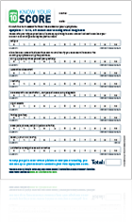
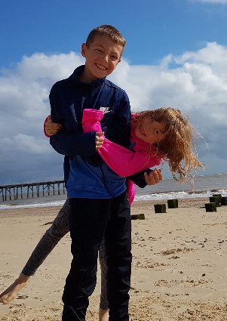
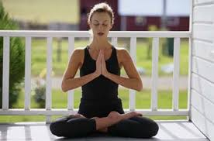
What people can do to help themselves – now and in the future
Nutrition
Exercise
Smoking/alcohol/drugs
Alternative treatments
complimentary therapies
Supplements e.g turmeric (Curcumin)
Cannabis oil (CBD)
Record Symptoms/experiences
Communicate – family/friends/healthcare professionals
Immunisations
Medications – i.e analgesia
?

Slide 10
When to seek medical help
Greeen
Green – slight cold, ear infection, everyday minor health issues or questions/ requests that are not urgent
Yellow – not sure if should go to A & E or wait until morning…..
Red –Immediately life threatening = collapse, unresponsive, 112/999/911

Slide 11
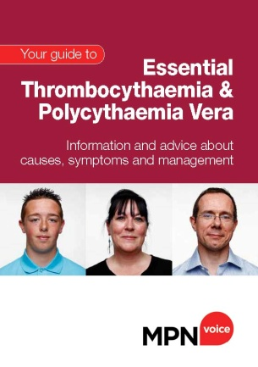
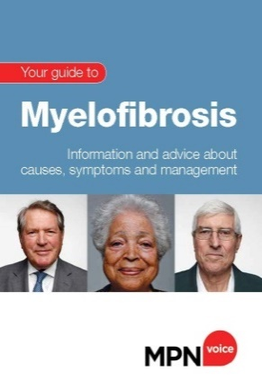
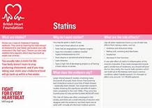
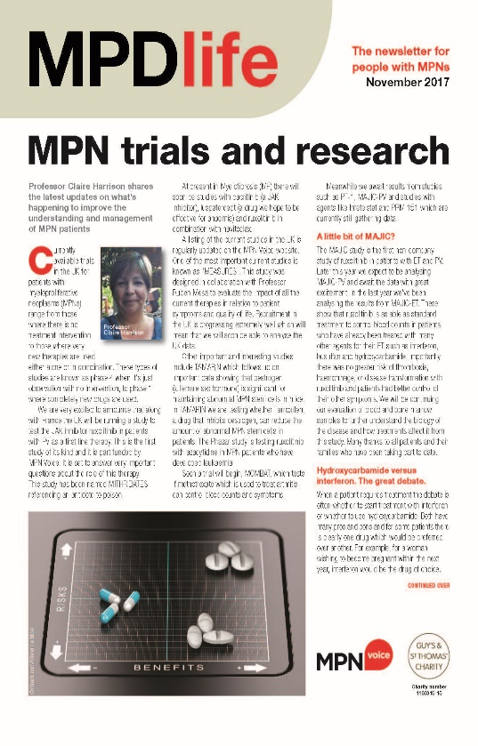
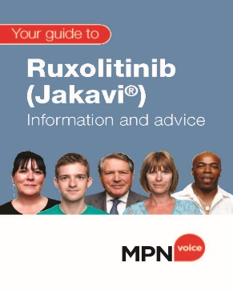
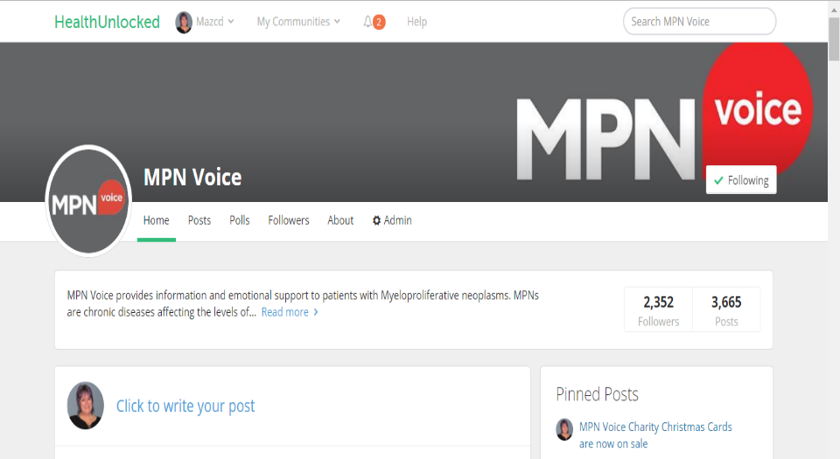
Where to find out more
MPN resources
Local
National
International
General health education / other conditions
Internet Dr Google ?!

Slide 12
Summary
Patient and Carer
Enjoy better quality of life, increased self confidence and achieve outcomes that are important to them
Experience better clinical outcomes
Health care Professionals
Enables to have more meaningful conversations with patients and greater impact from, and satisfaction with their practice
Deliver services in more ‘joined up way’

Slide 13
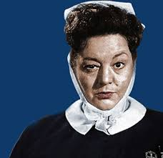
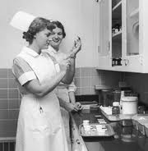
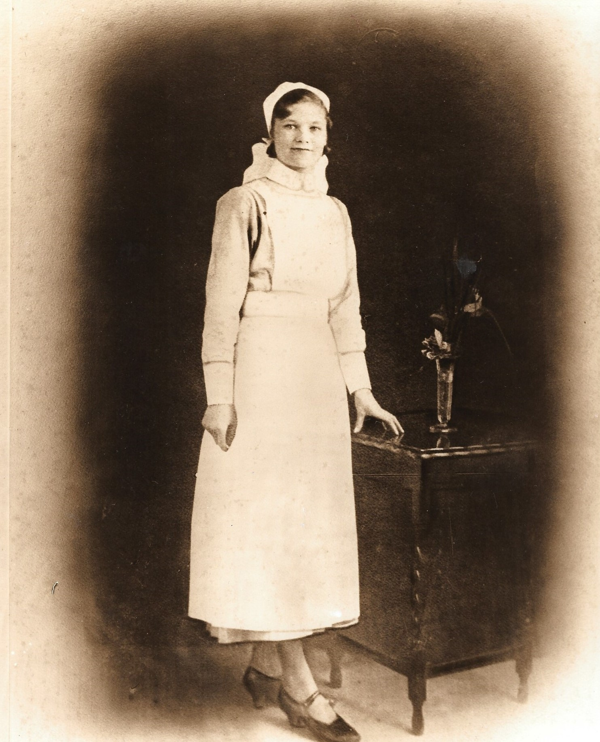
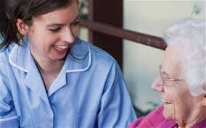
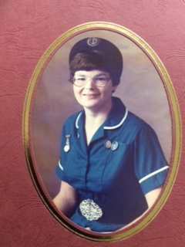
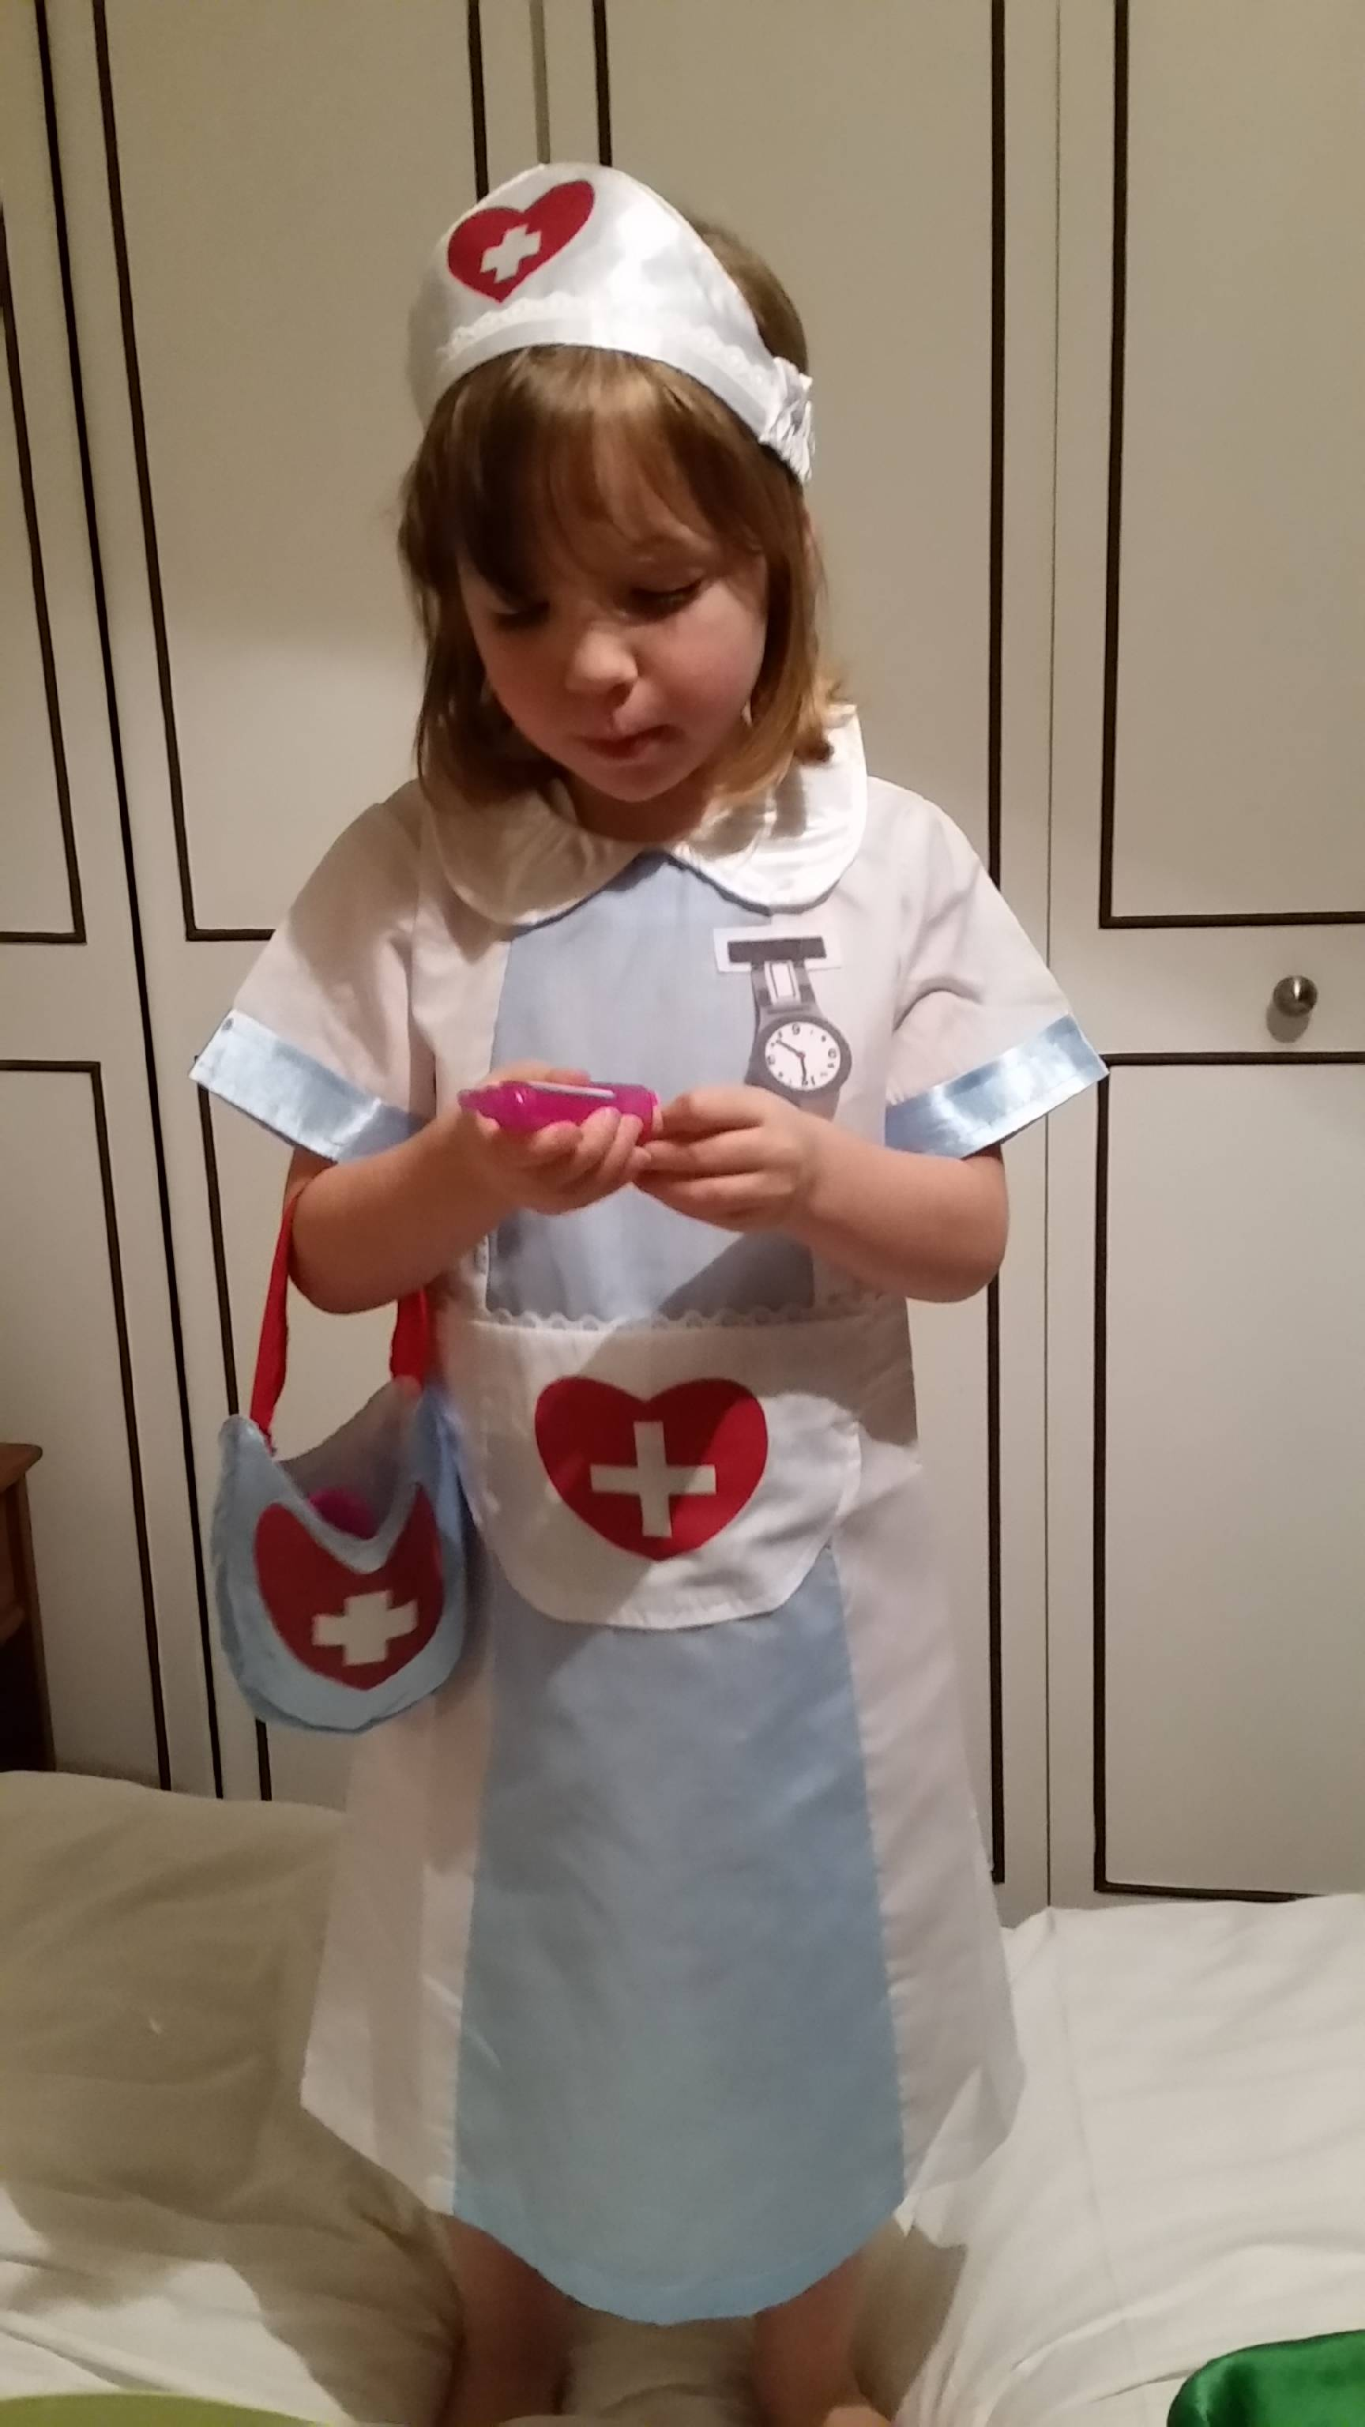
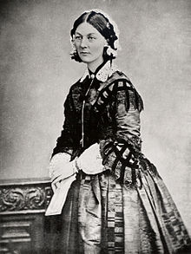
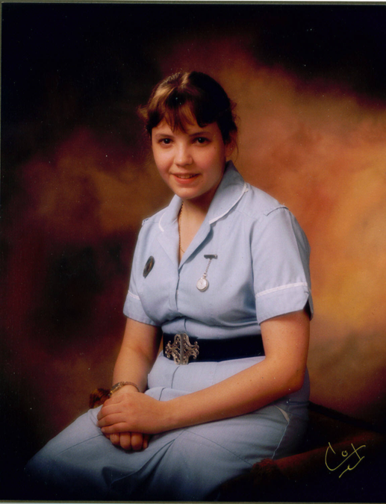
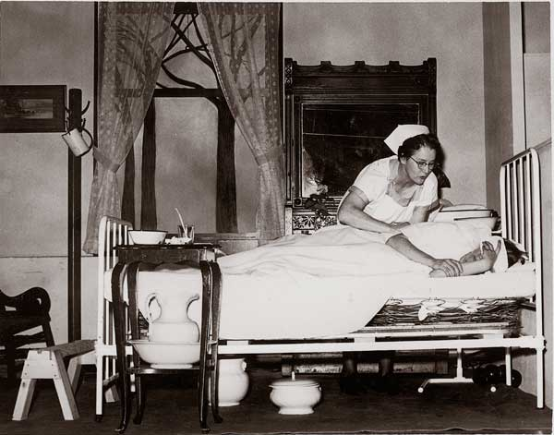
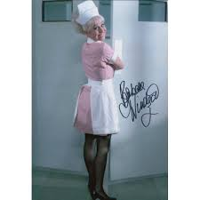
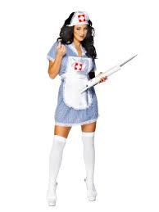
Thankyou!
Notes:
Tend to use this as the close – saying all nurses are different and work differently but achieve the same endpoint . But not compulsory!!!!

