Slide 1
How I manage patients who resist conventional therapy: tales from the clinic
Martin H. Ellis MD
Hematology Institute and Blood Bank
Meir Medical Center
Sackler School of Medicine, Tel Aviv, Israel

Slide 2
Outline
Extent of the problem
Identifying reasons for patient reticence
Working with the patient
Finding ways forward

Slide 3
Extent of the problem-my experience
Variable but unknown
More among newly diagnosed patients
More among patients with multiple illnesses
More among poorly informed patients

Slide 4
Identifying reasons for patient reticence
Fear of the unknown (re- disease and re- treatment)
Prior beliefs
Naturalist/holistic approach
Poor understanding
“Not another pill!”

Slide 5
Identifying with the patient
“The tale of the boy who thought he was a turkey”

Slide 6
Finding ways forward
“The secret of care of the patient is caring for the patient” (Francis Peabody)
Building trust
“The doctor as a drug” (Michael Balint)
Engaging trusted proxies

Slide 7
Some examples
78 y.o woman with ET – “No poisons for me”
Engaged her in activities of MPN patient group-empowerment
64 y.o. woman with ET – “I’m a fitness fanatic”
More frequent monitoring; reinforcing guideline-based management
54 y.o. man with P vera and intellectual impairment – “Needles scare me”
Family support, music, medical clown →Hydroxyurea
56 y.o. man with P vera – “Hijama for me”
He wins

Slide 8
Hijama- Arabic for “sucking”

Slide 9
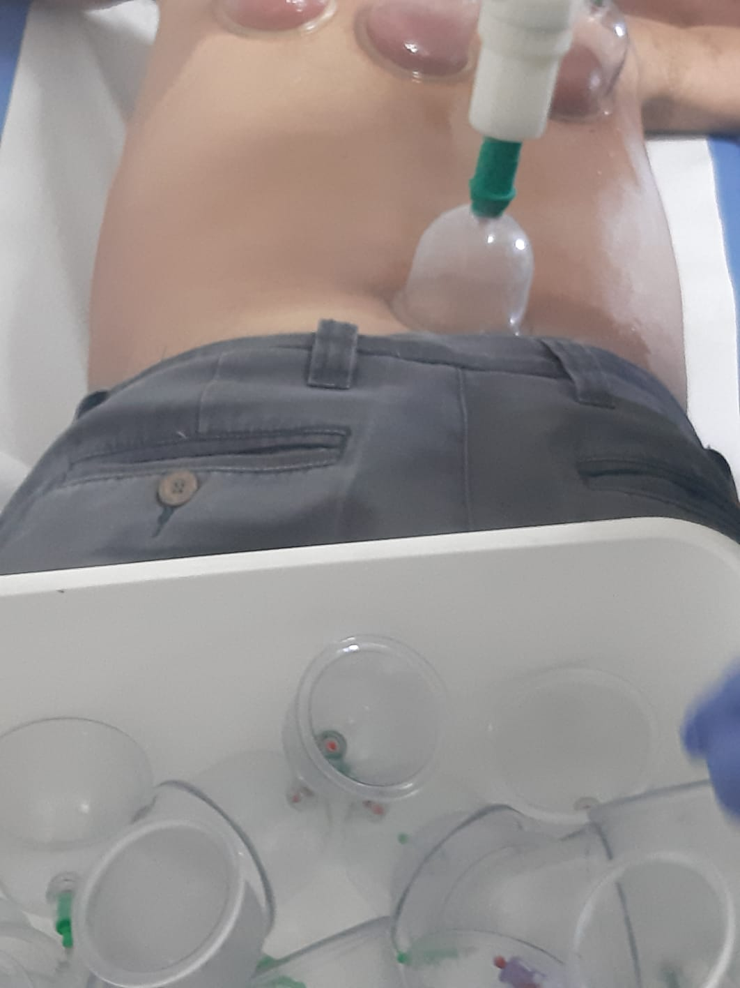

Slide 10
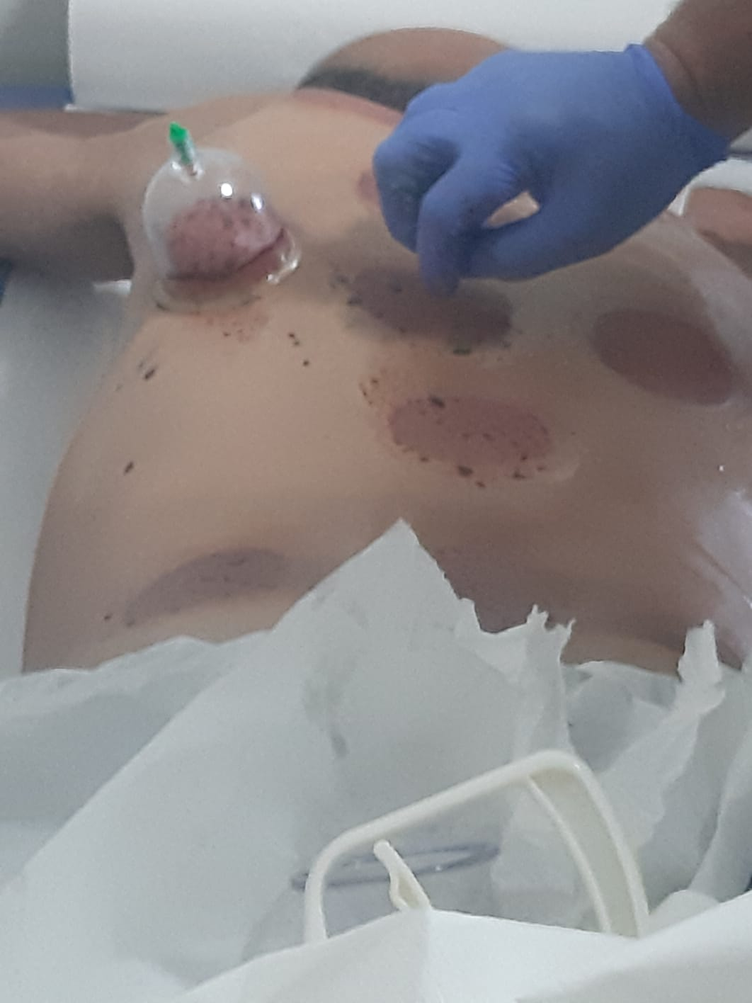

Slide 11
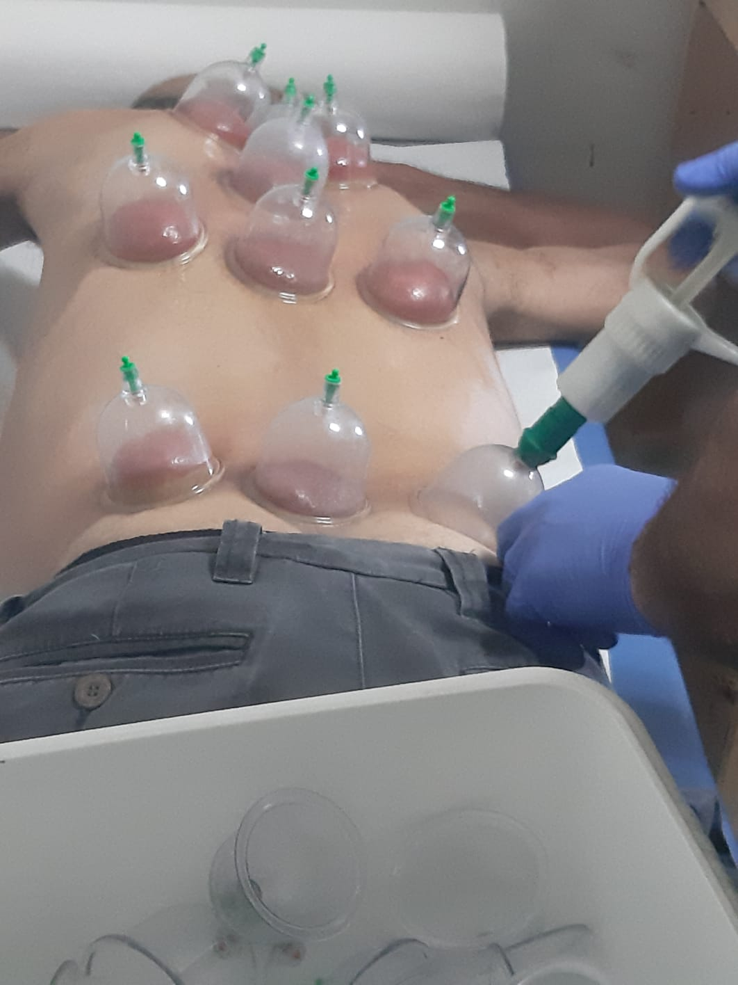

Slide 12
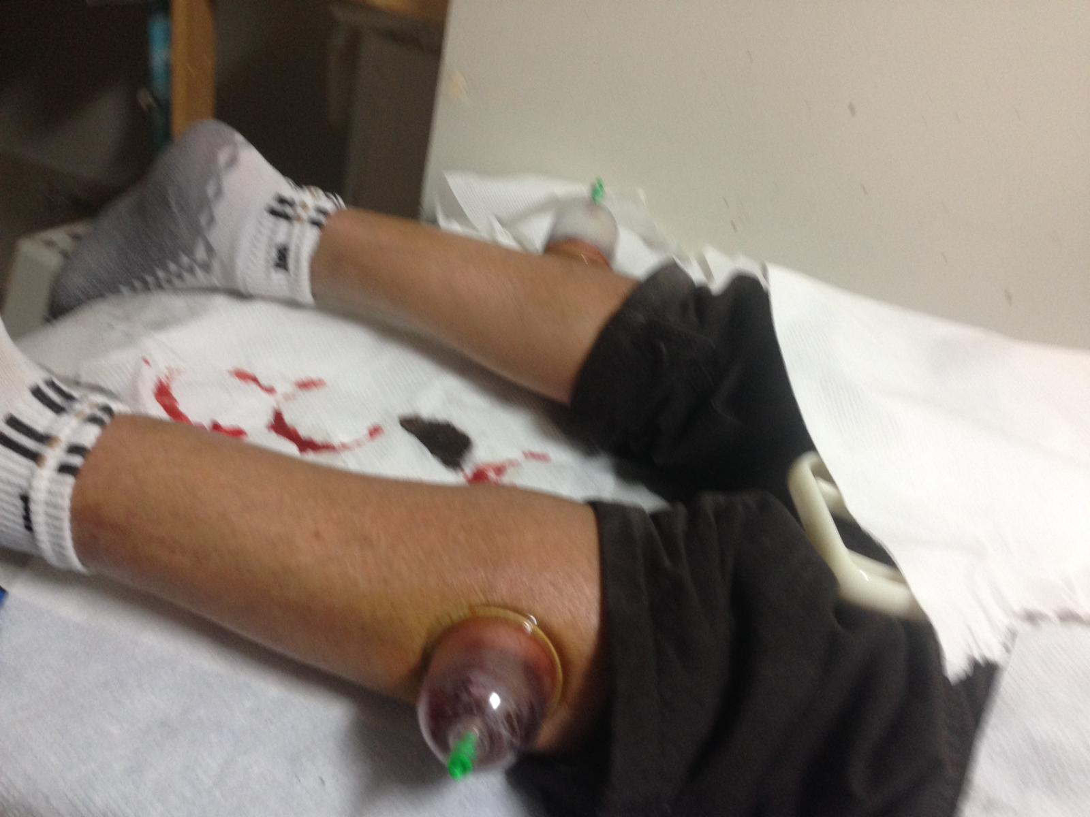

Slide 13
